Slide 1



Academic Orientation and Evaluation System

Slide 2
Key Academic Resources
Programme Guide: Contains detailed Programme Scheme and syllabus of all the courses with examination related weightages
Available on Website and Learning Management System
e-Learning Material (e-LM): e-Book containing all the course content covering the entire syllabus of the course. It is written in the Self-Learning and conversational style
Available on Learning Management System
Sample
Sample

Slide 3
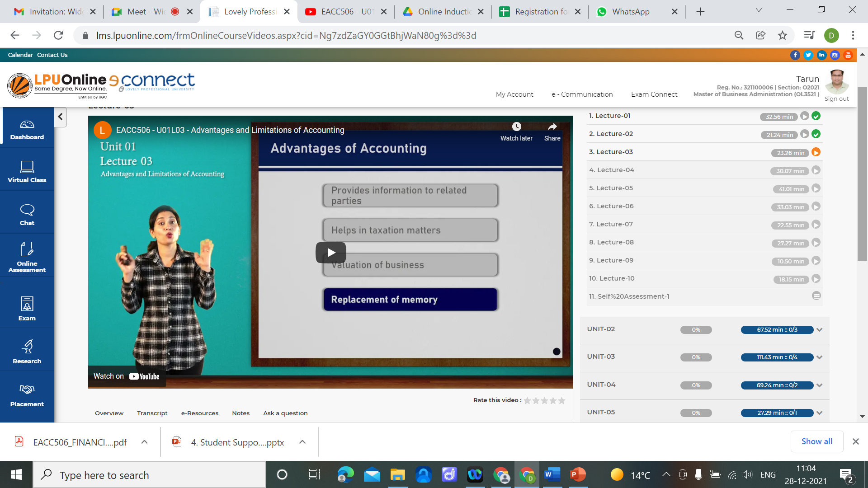
Academic Counselling Modes
Recorded Video Lectures (e-Tutorials)
LIVE Virtual Classes
Chat & Discussion Forum
Academic Workshops/ Master Classes/ Guest Lectures

Slide 4
Evaluation System
Assessment weightages for various Types of Courses:
End Term Exam:
End Term Examinations are conducted through Online Proctored Exam System.
Course Category | Assessment Weightage
 | Continuous Assessment |  | ETE | ETP
 | Assignments | Academic Participation and Engagement
Theory only courses | 20% | 10% | 70% | NA
Dissertation/ Capstone Project | 20% | 10% | NA | 70%
Practical and theory-based courses | 20% | 10% | 40% | 30%
Term Paper/ CDP/ Field Project/ Seminar on Summer Training | NA | NA | NA | 100%

Slide 5
Continuous Assessment & Assignments
Continuous assessment: : This component evaluates a student's progress throughout the prescribed course. It shall compromise of:
a. Assignments
b. Academic Participation
The periodicity of assignments shall be as per the table given below:
Type of Course | Number of Assignment to be allocated
Courses with 4 credits | 2
Courses with 6 credits | 3

Slide 6
Assignments
Assignments shall be provided to the students through the Learning Management System.
After downloading and printing the assignment questions, students are required to write the answers in their own handwriting followed by scanning and uploading the same through the CA submission interface as per the stipulated timelines.
Pattern to be followed for assignments:
Each Assignment would consist of two questions of 10 marks each
Total marks assigned to each assignment: 20

Slide 7
Academic Participation and Engagement
Students are expected to maintain full academic participation in all courses.
Academic participation and engagement shall carry a weightage of 10%.
The minimum participation percentage of students in various academic activities should be 75 %.
The marks to be awarded shall be on the basis of their attendance/ participation in:
LIVE virtual classes
Recorded Lectures
Online Self-Assessment Quizzes
Discussion Forum

Slide 8
End Term Examination
Question paper would consist of mix of Objective as well as Subjective Questions.
End Term Practical/ Project Examination would consist of:
Online Practical/ Presentation and Viva based on the practical/ project report submitted by the student.
Schedule of the Practical/ Project Exam shall be intimated to students along with the date sheet for End Term Examination.

Slide 9
Provision of Re-appear/ Re-evaluation
Re-appear: Student getting E grade in End Term Exam can register for Re-appear in any of the subsequent end term exams scheduled by the university within the maximum duration of the programme as per the applicable fee per course.
Re-evaluation: Students not satisfied with their marks/ grade in the End Term Exam, can apply for Re-evaluation in that exam (Theory only) as per the applicable fee per course.
Registration for both these provisions would be done only through LMS as per the dates announced by the University from time to time.

Slide 10
Passing Criteria
In order to achieve a passing grade in a course the learner must fulfil the following minimum conditions:
Theory-only course: Score 30% marks in ETE along with 40% marks overall in all components when combined together (CA and ETE).
Theory and Practical course: Score 30% marks separately in ETE and ETP along with 40% marks overall in all components when combined together (CA and ETE)
Dissertation/ Capstone Project: Score 30% marks in ETP and achieve 40% marks when ETP and CA taken together.
Term Paper/ CDP/ Field Project/ Summer Training: Score 40% marks in ETP
CGPA Condition: In addition to the above passing conditions, the learner must achieve a minimum overall CGPA of 5 to complete the programme successfully.
Conversion factor to convert CGPA into % shall be 10.

Slide 11
Thank you

