Slide 1



MY CLASS INTERFACE

Slide 2
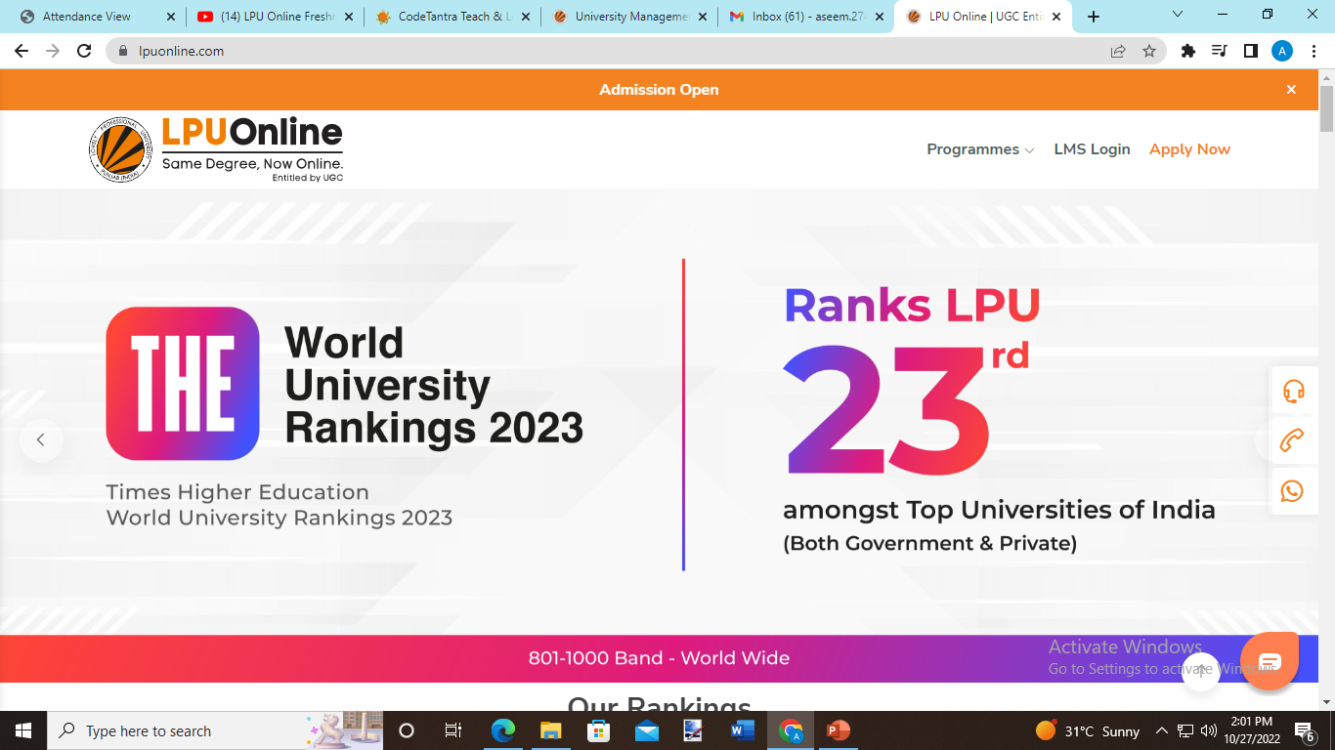

Slide 3
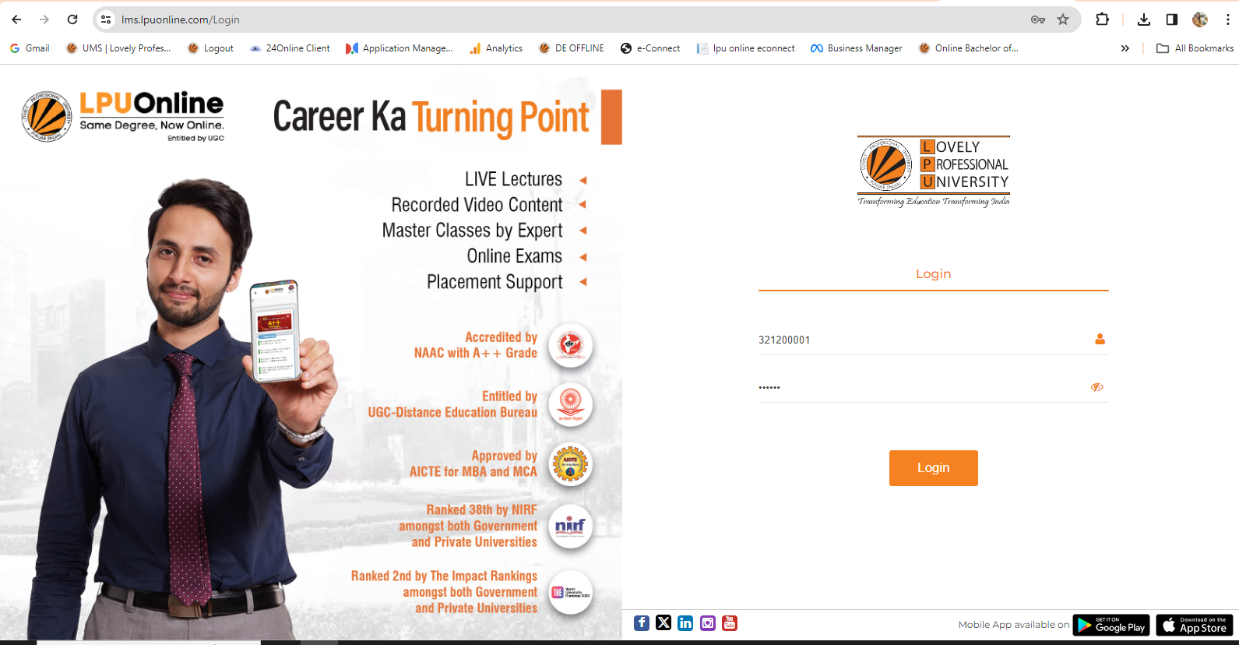
LMS Login Screen for Students

Slide 4
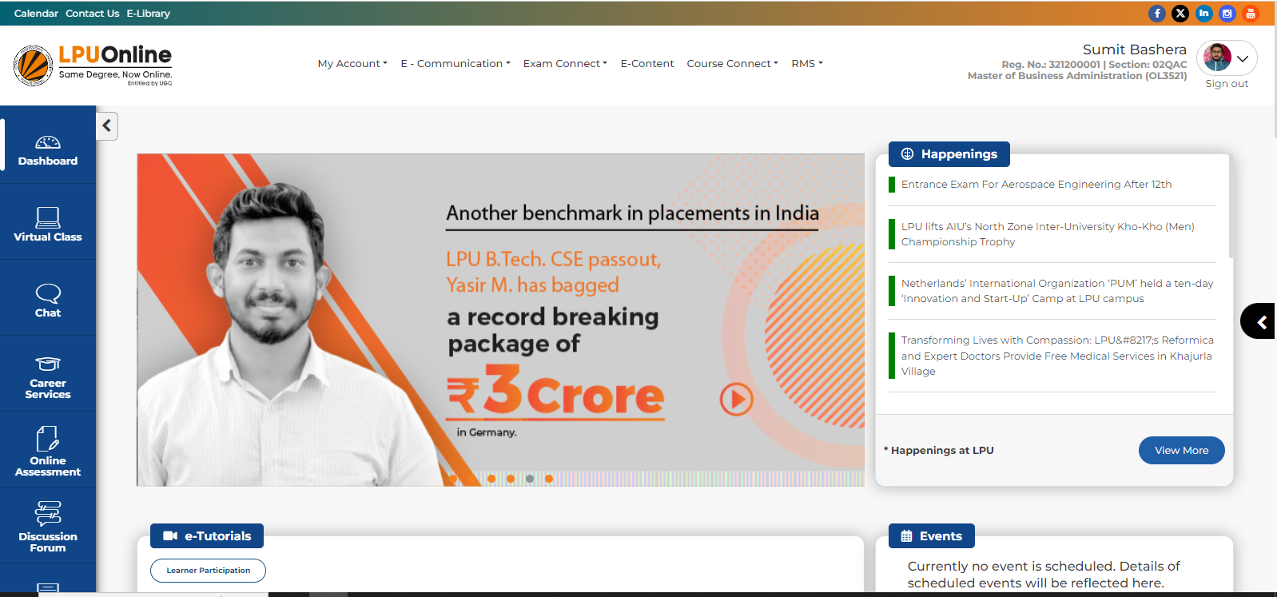
Virtual Class Link on Dashboard

Slide 5
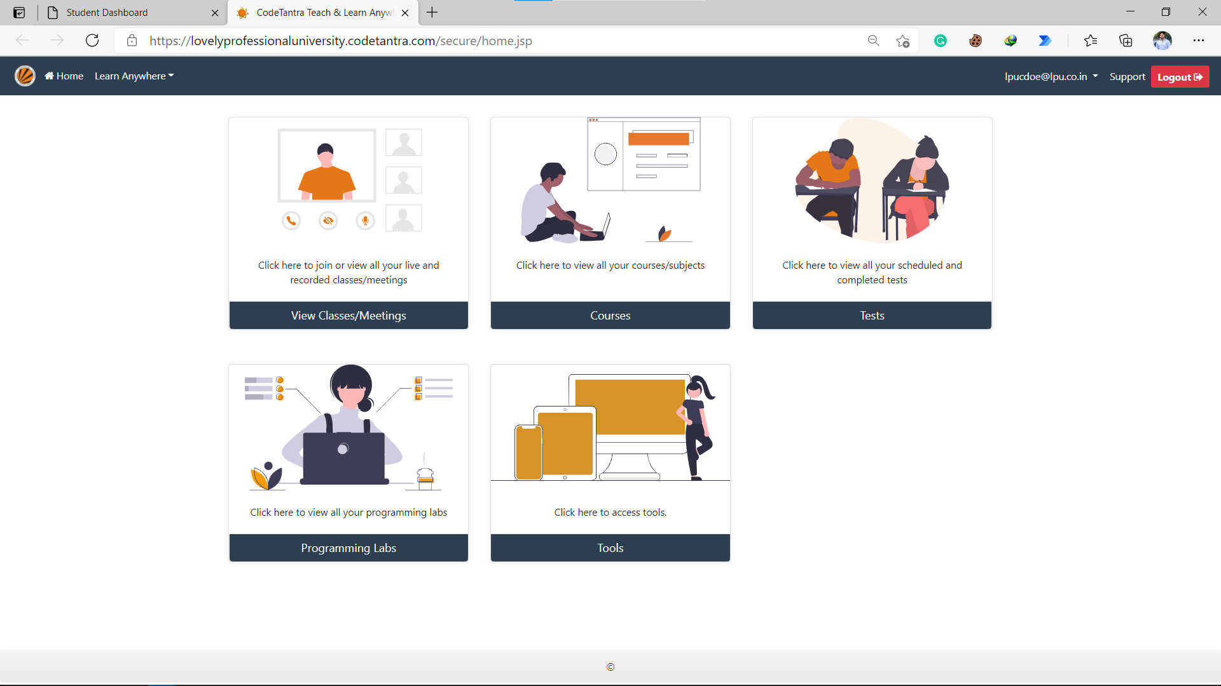



Slide 6
Virtual Class

Slide 7
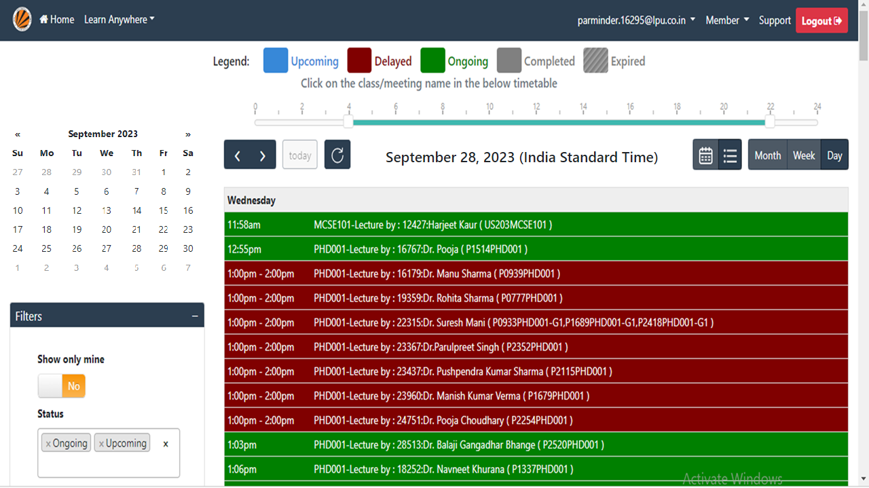

Slide 8
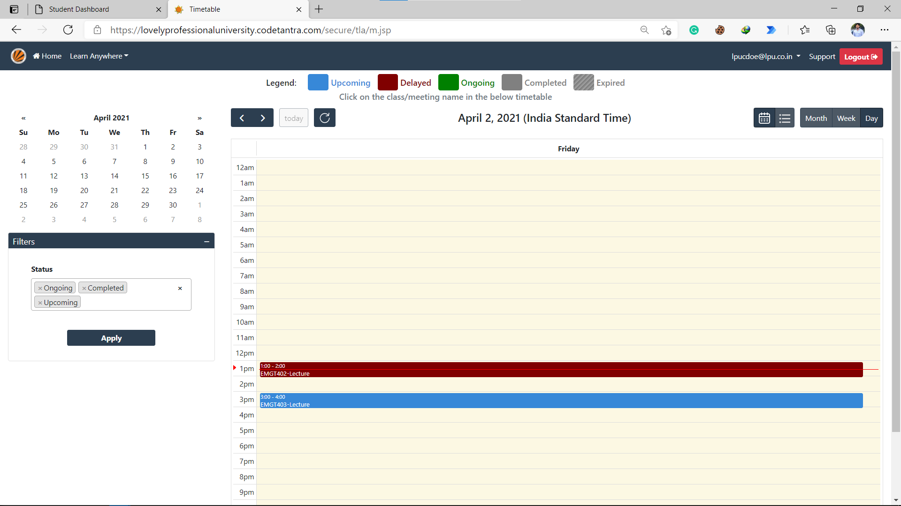
Scheduled Classes are shown in the calendar here

Slide 9
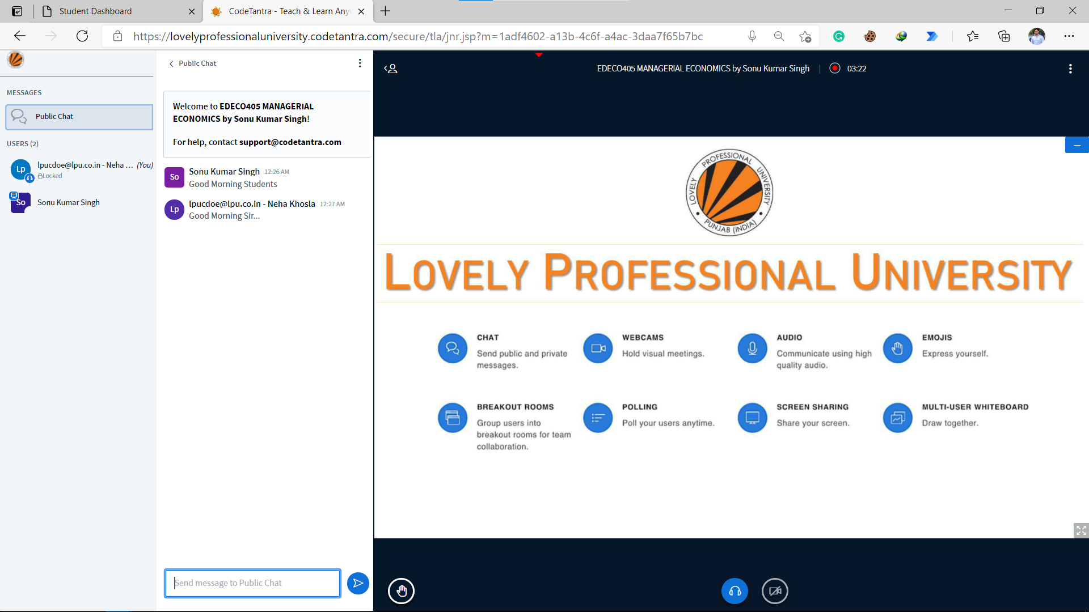

Slide 10
Presentation Area to view uploaded ppt by the teacher

Slide 11
Public chat area to communicate with either faculty member or classmates

Slide 12
List of participants of class

Slide 13
Buttons to raise hand and to control audio and video

Slide 14
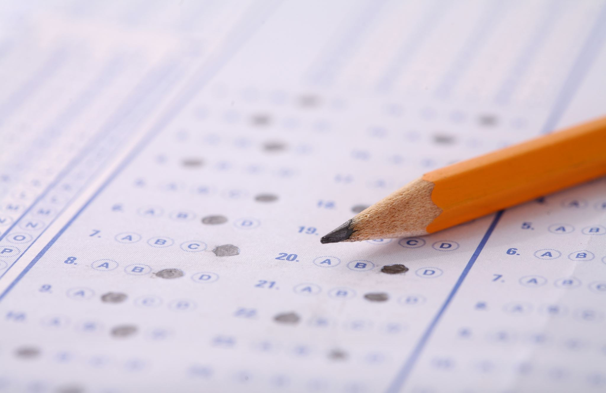
Quiz

Slide 15
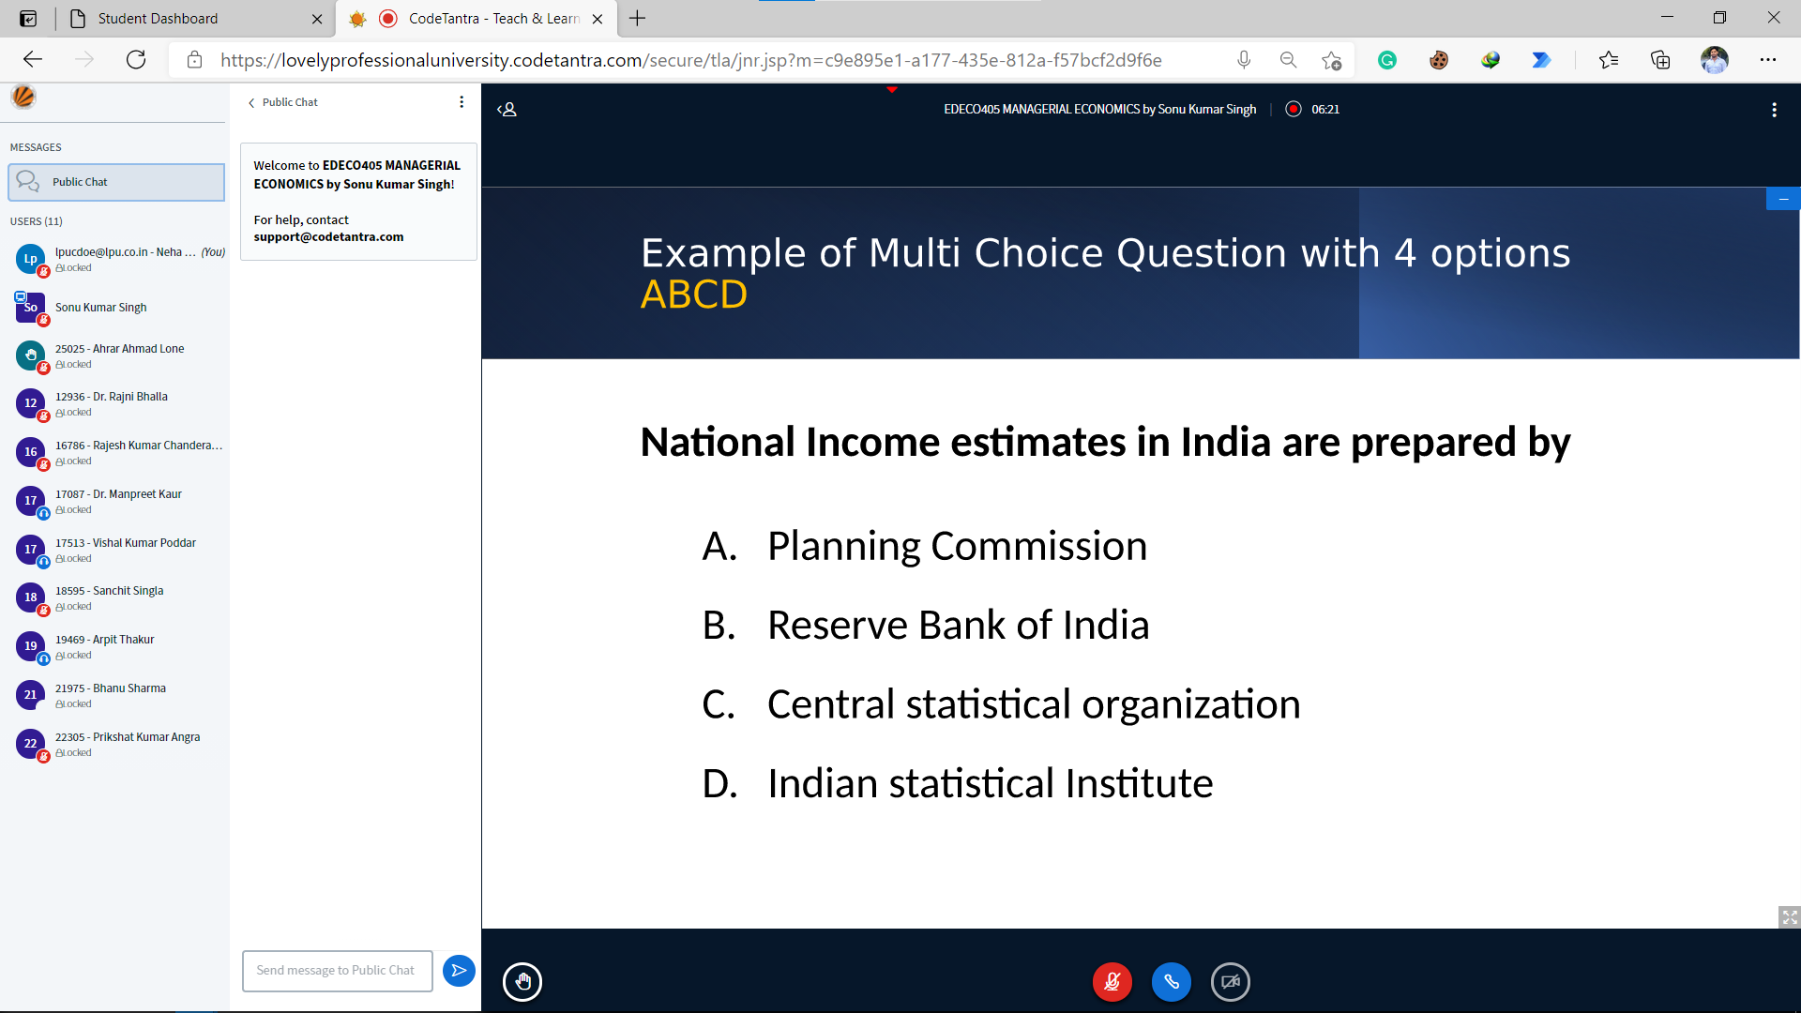
Student Interface

Slide 16
Student Interface
Quiz questions are placed within the presentation file to be uploaded by the teacher and responses from students are collected through polling

Slide 17
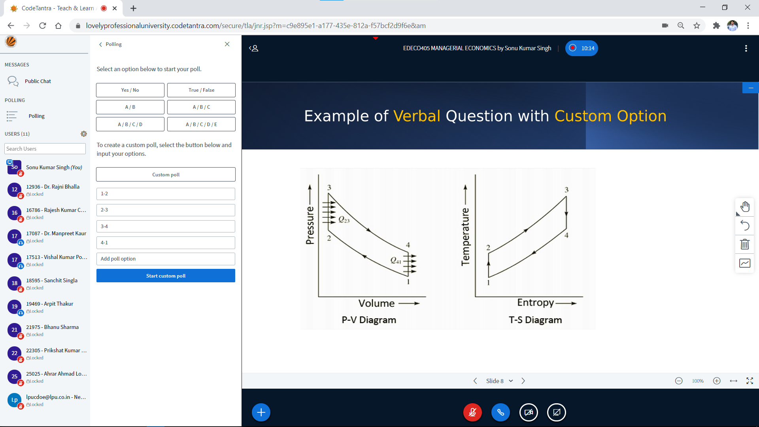
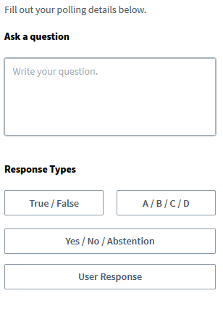
Teacher Interface

Slide 18
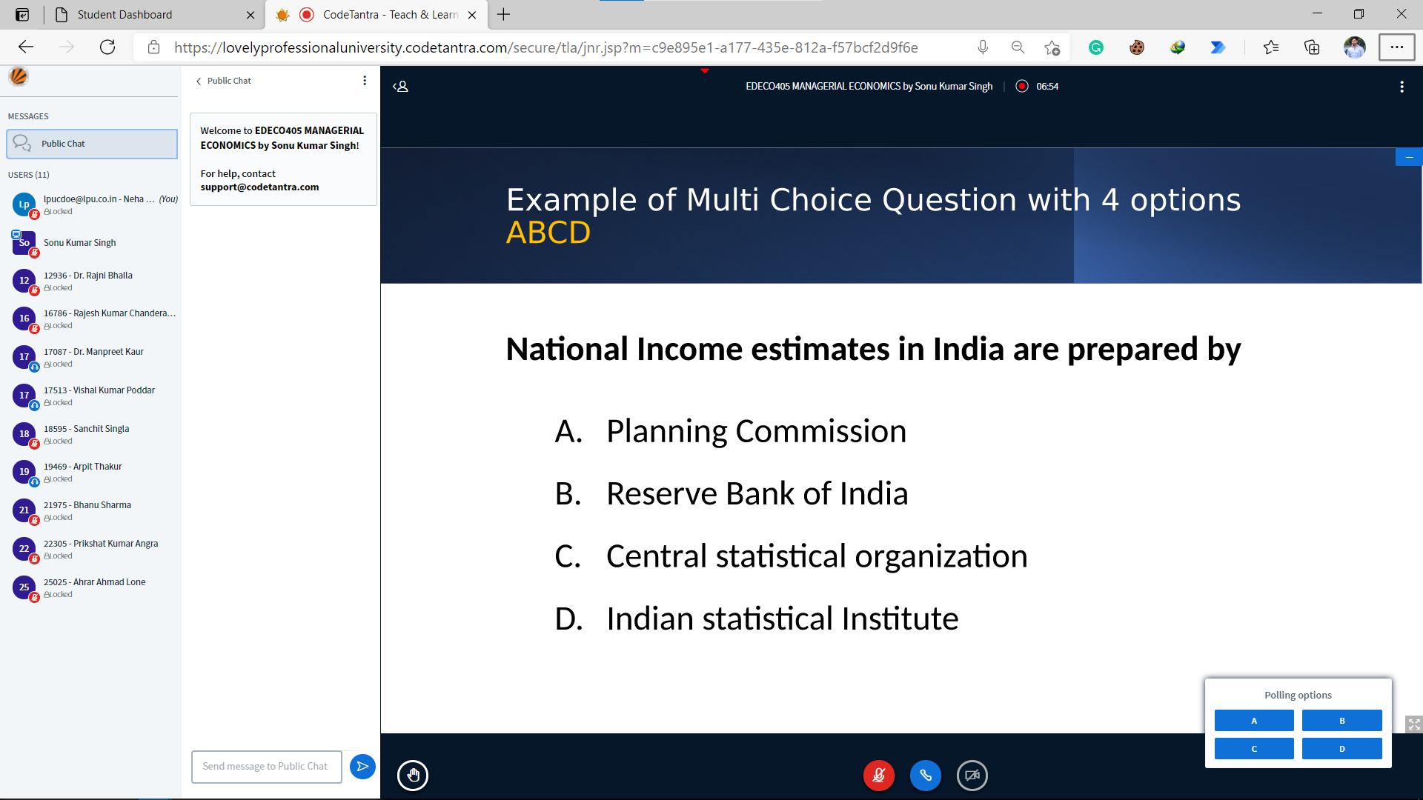
Student Interface
Polling Options

Slide 19
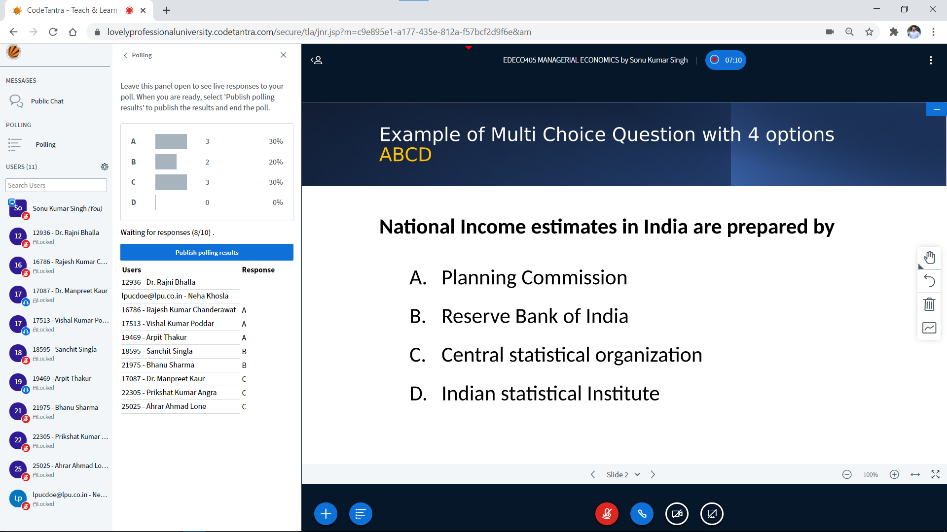
Teacher Interface
Realtime Analytics of the Student Response
Poll results can be published
Student who has not responded yet
Facility to track individual Student Response

Slide 20
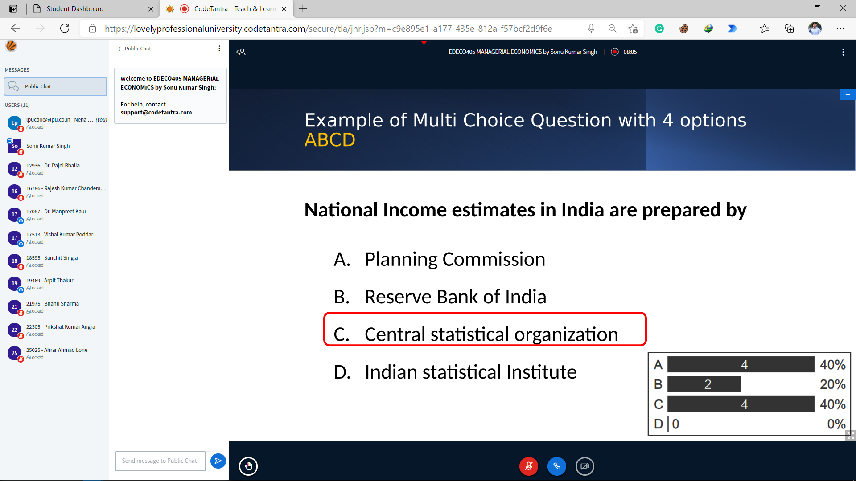
Student Interface
Polling Options

Slide 21
Breakout Room

Slide 22
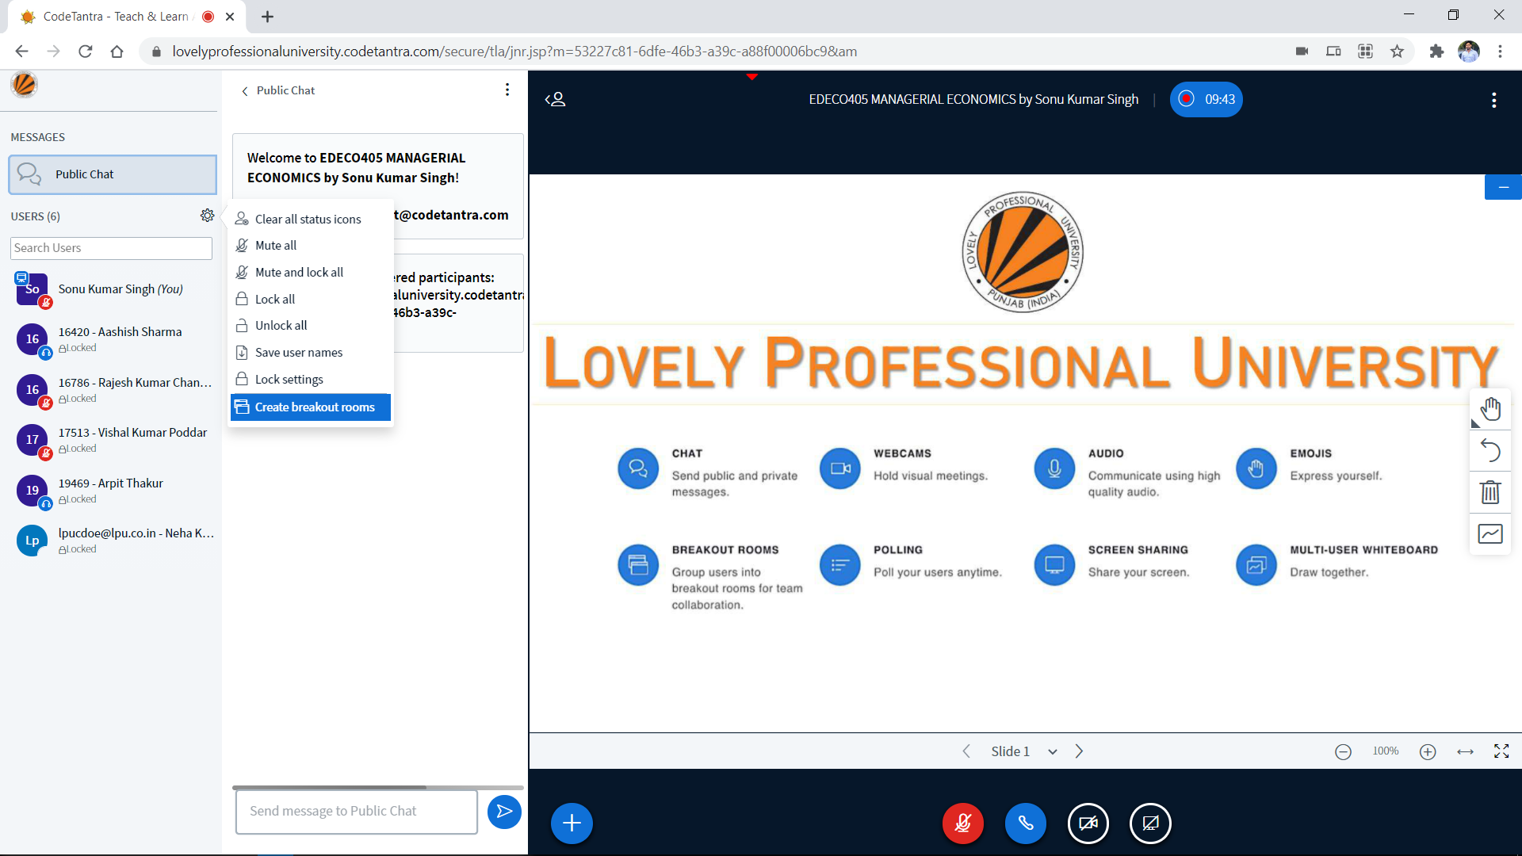

Slide 23
Integrated Breakout Room Features for Group Activity

Slide 24
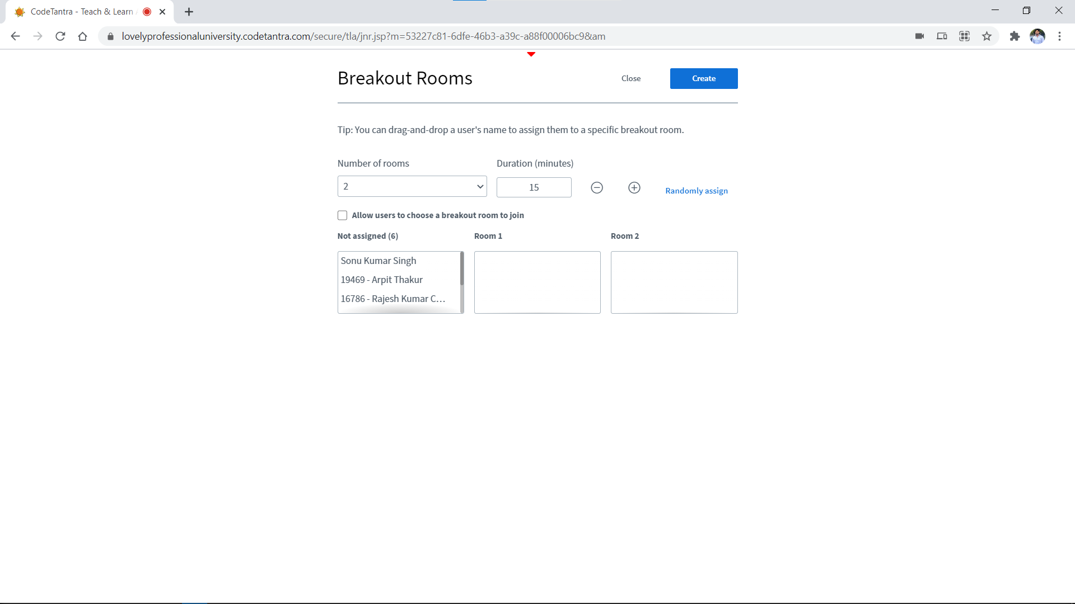

Slide 26
Teacher has control to create number of breakout rooms

Slide 27
Teacher has control to set duration for breakout rooms

Slide 28
Teacher has control to randomly assign students in created Breakout Rooms.

Slide 29
Teacher can allow students to choose the breakout room as per their choice.

Slide 30
List of all students is available for the teacher to assign students as his/her requirements.

Slide 31
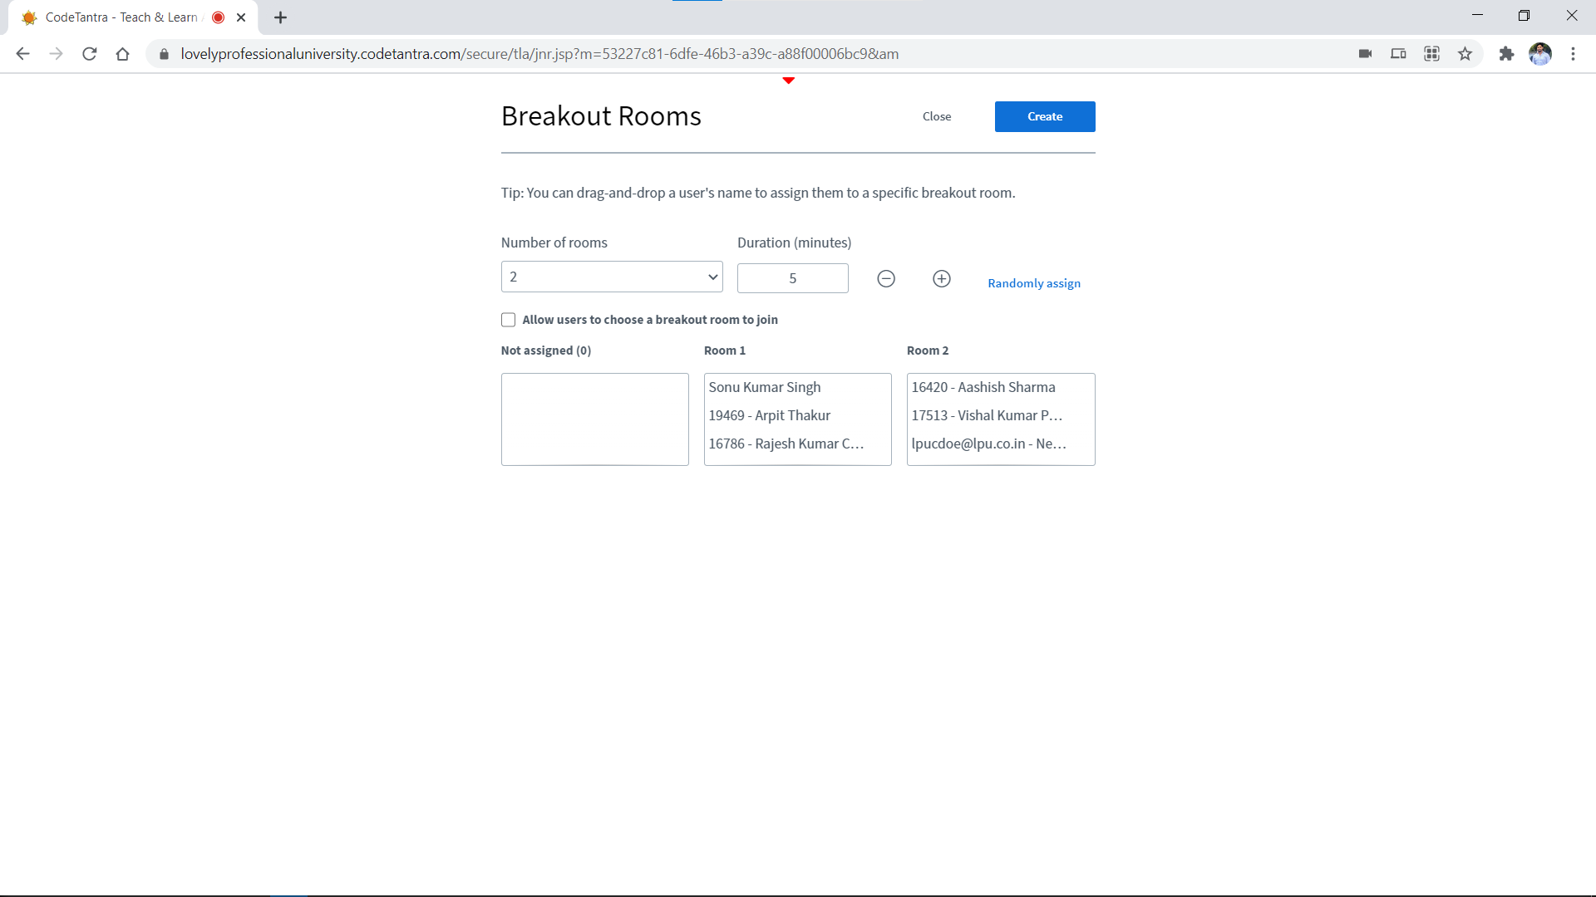
Example of Assignment of students into multiple Breakout rooms manually

Slide 32
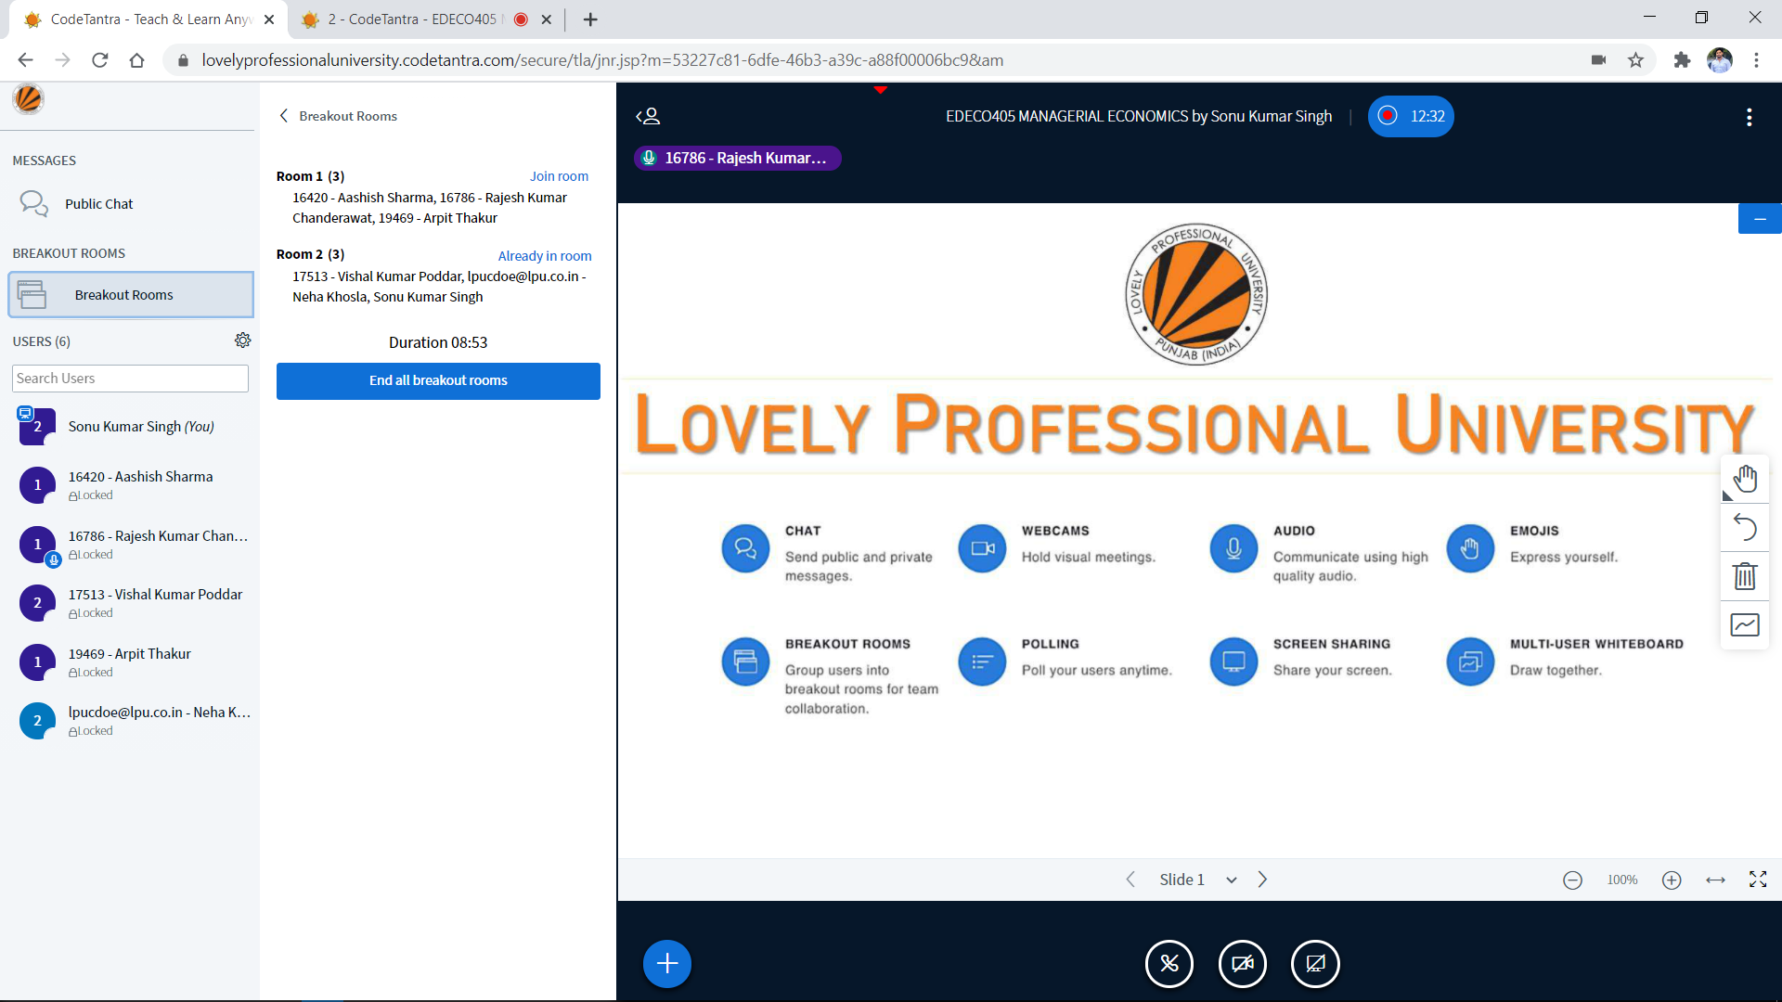

Slide 33
Lecture Recording

Slide 35
Virtual Class

Slide 36


Slide 37
Select the appropriate date from the calendar

Slide 38
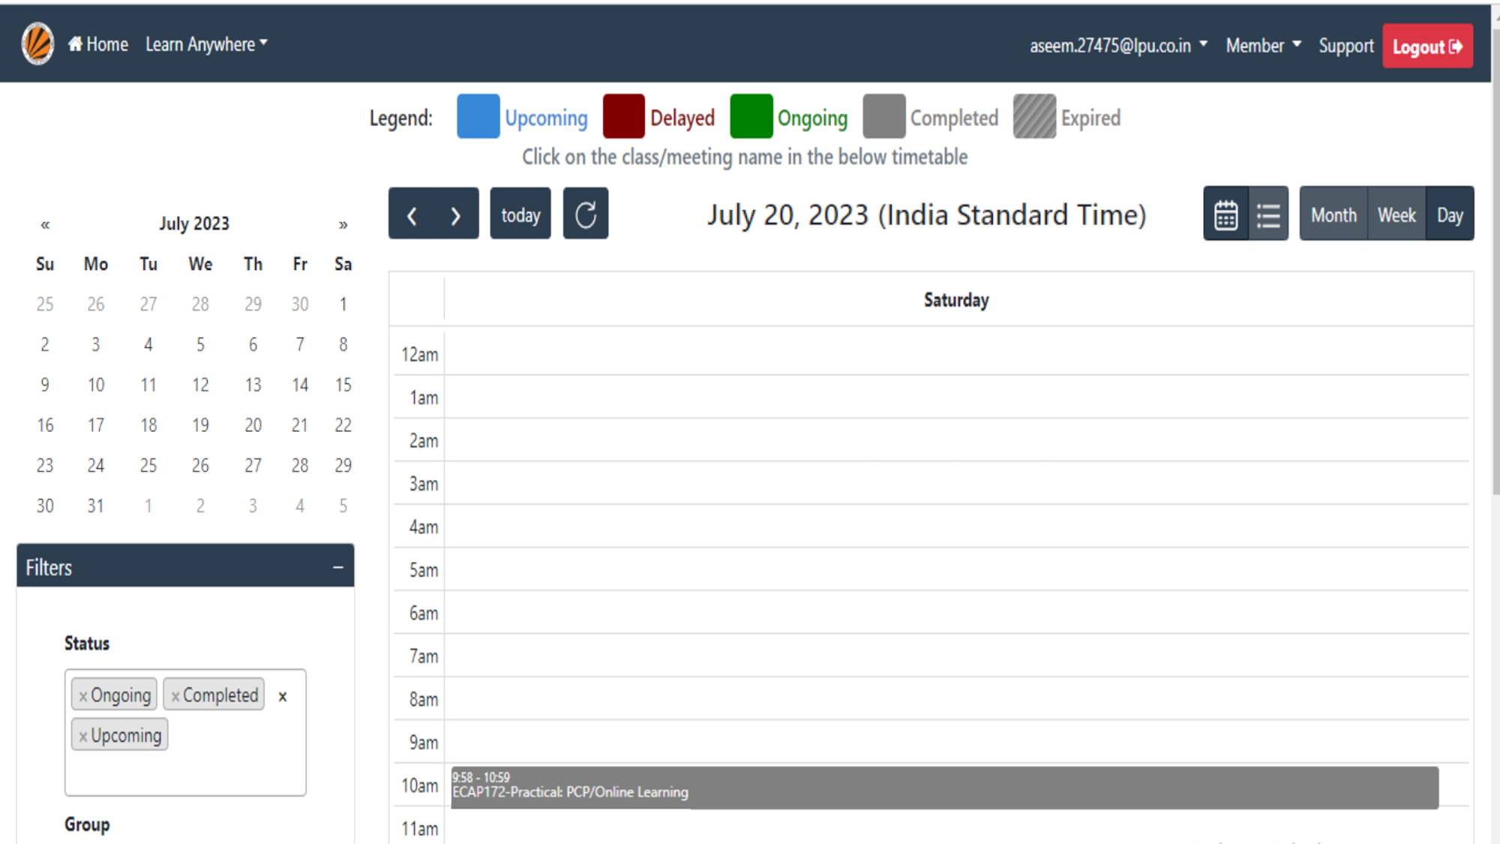
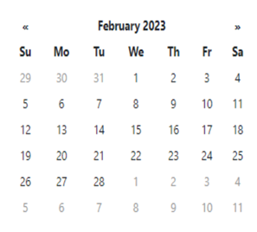

Select the right class to view the class details.

Slide 39
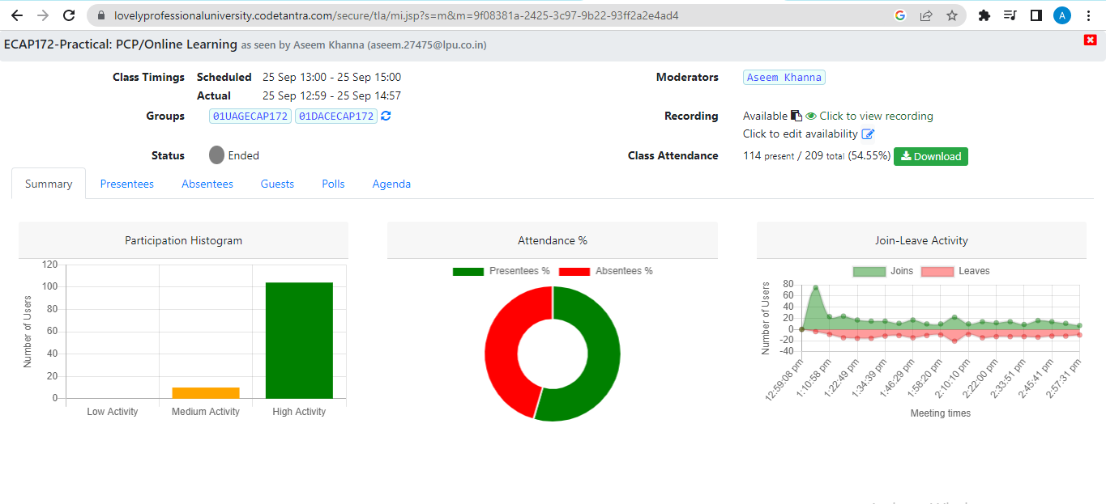

Slide 40

Select Click to view Recording link to view the recording

Slide 41
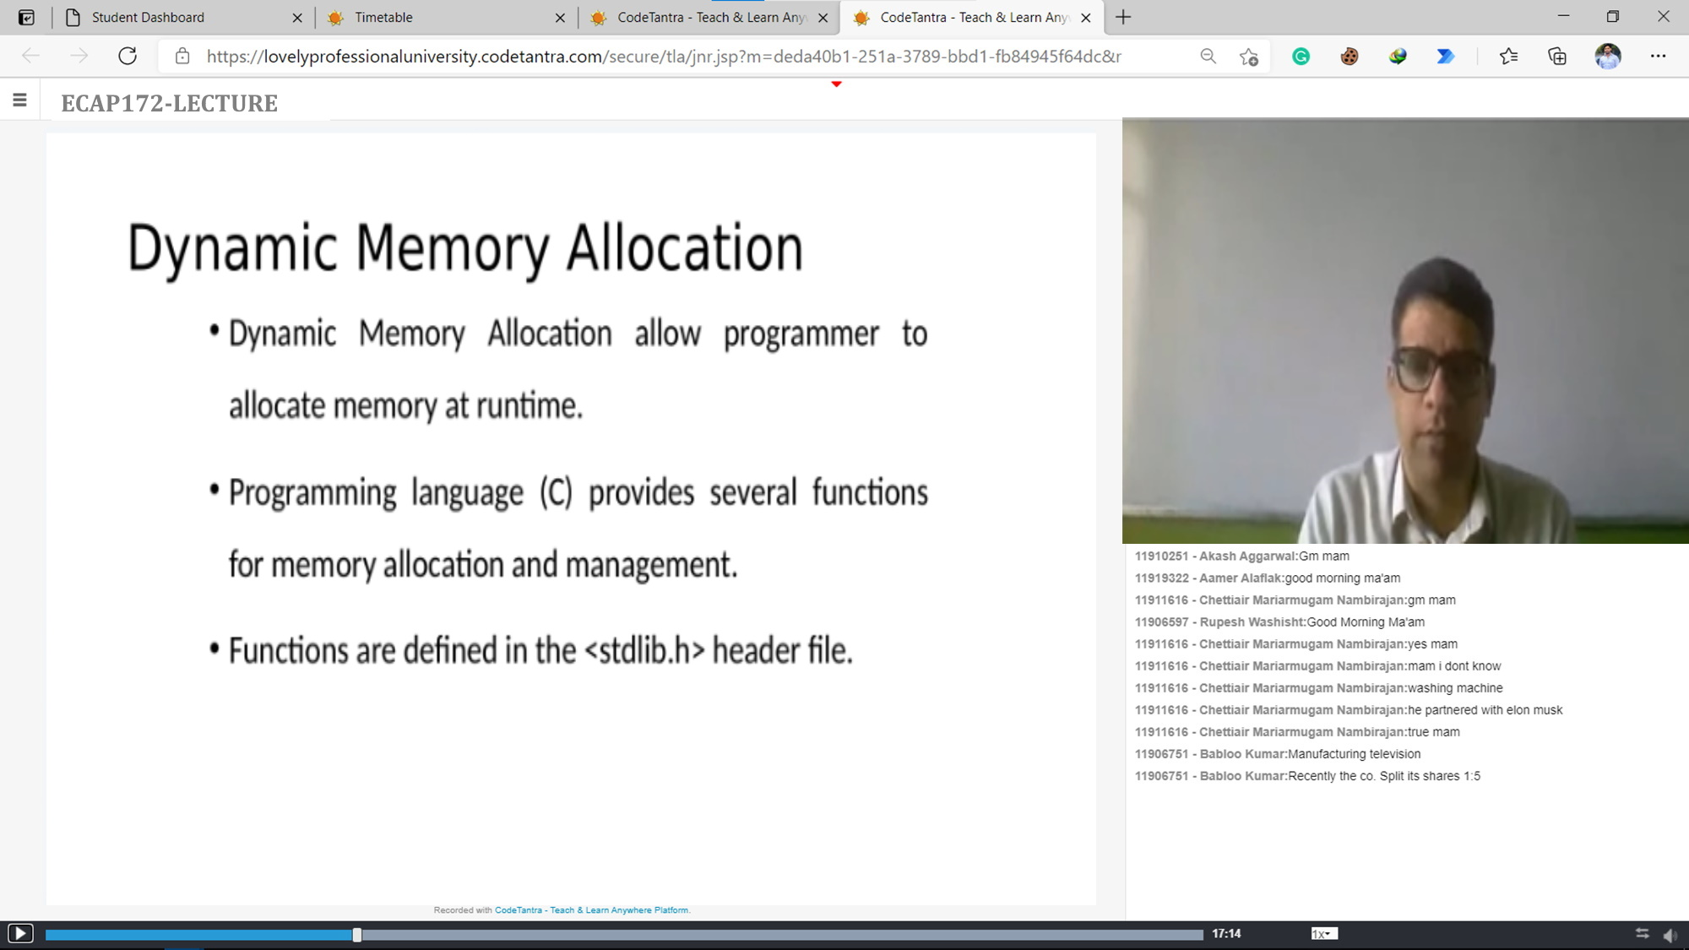

Slide 42
Video Series
How to Join LPU MyClass
https://youtu.be/eqLFcrZXwL8
How to Interact with your Teacher
https://youtu.be/0Uzaujrv9tY
How to Use Presenter Tools
https://youtu.be/YS_Pewxus0Q
Giving Mobile Version Chrome Browser permission in Android phones
https://youtu.be/1FETOw0ujsM
How to end myclass with proper feedback
https://www.youtube.com/watch?v=YigXOEZrdCo

Slide 43
Online
Proctored
Examination

Slide 44
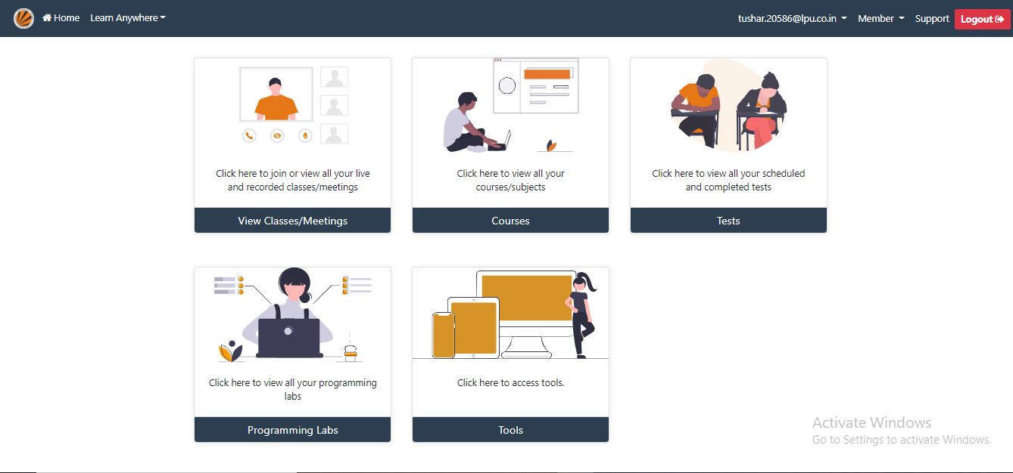
Proctored Exams on MyClass:

Slide 45
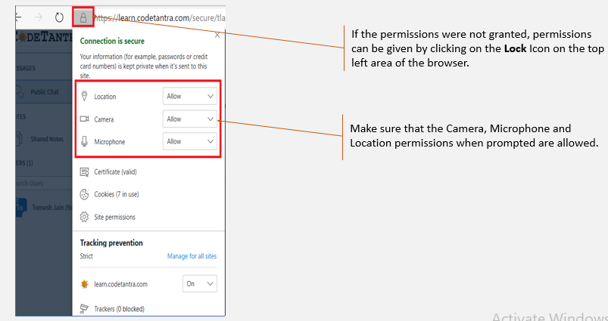
Before proceeding to test make sure following permissions to given:

Slide 46
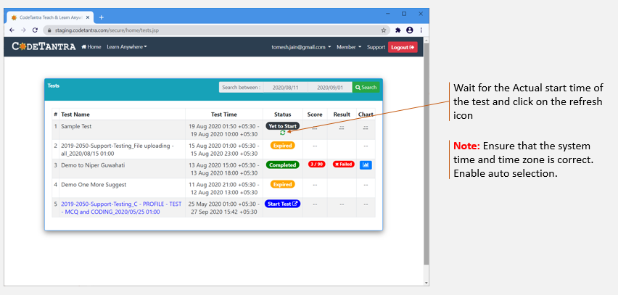

Slide 47
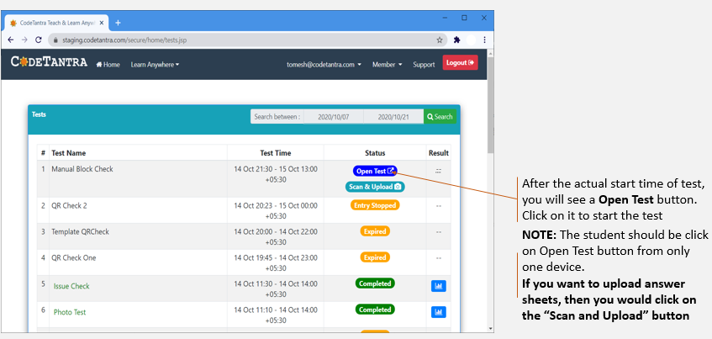

Slide 48
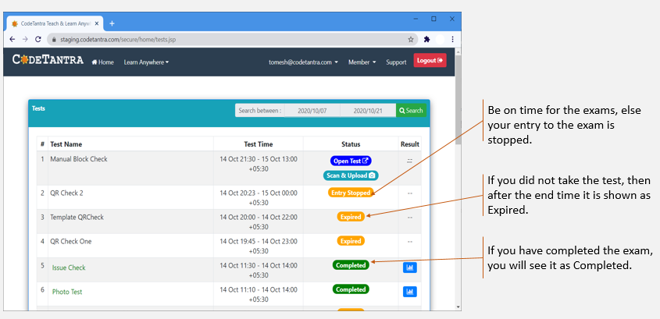

Slide 49
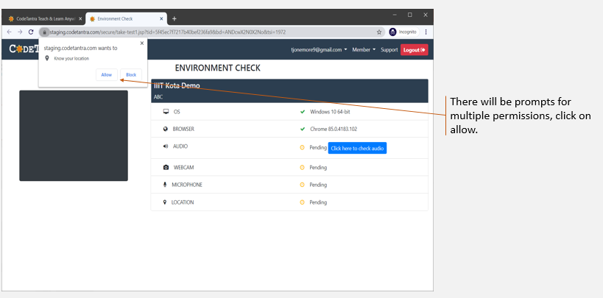

Slide 50
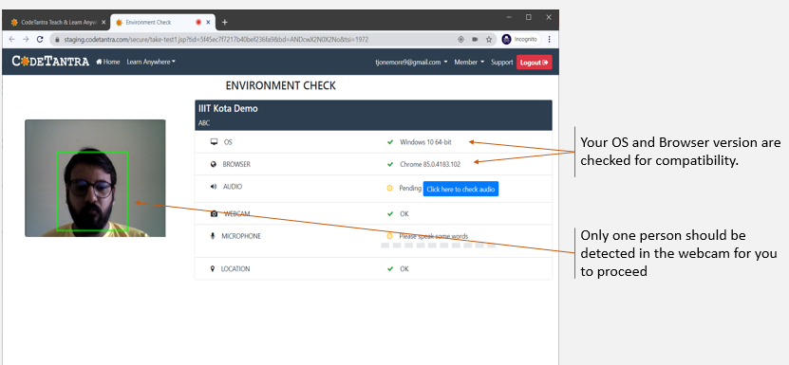

Slide 51
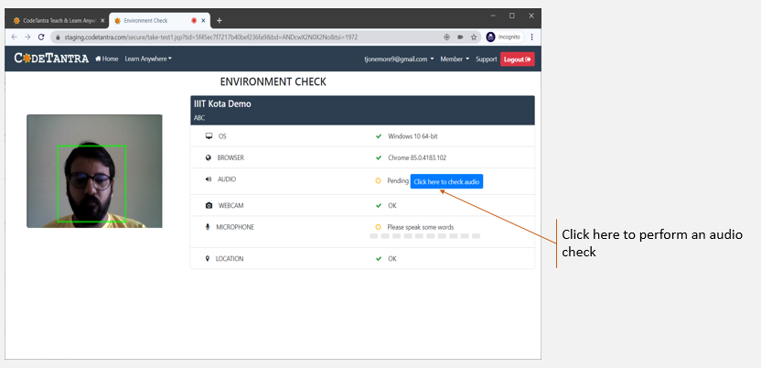

Slide 52
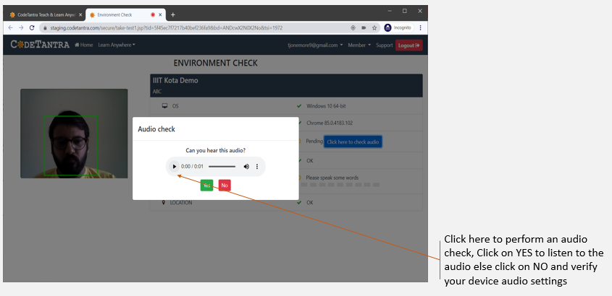

Slide 53


Slide 54
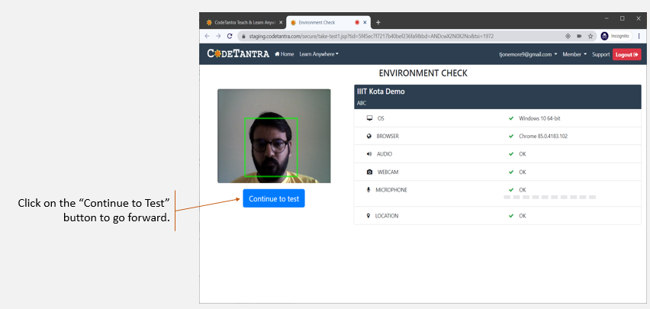

Slide 55
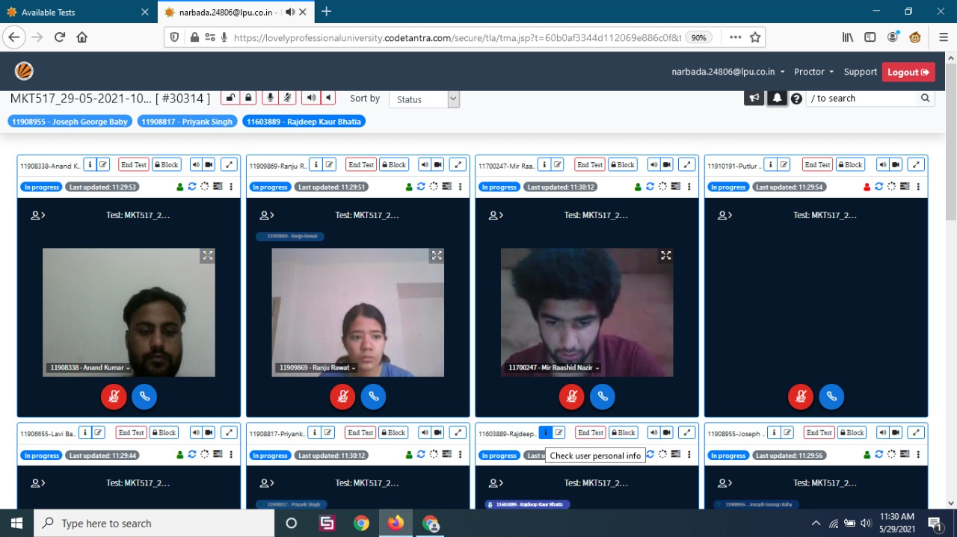
Teacher Interface

Slide 56
Access to e-Library

Slide 57
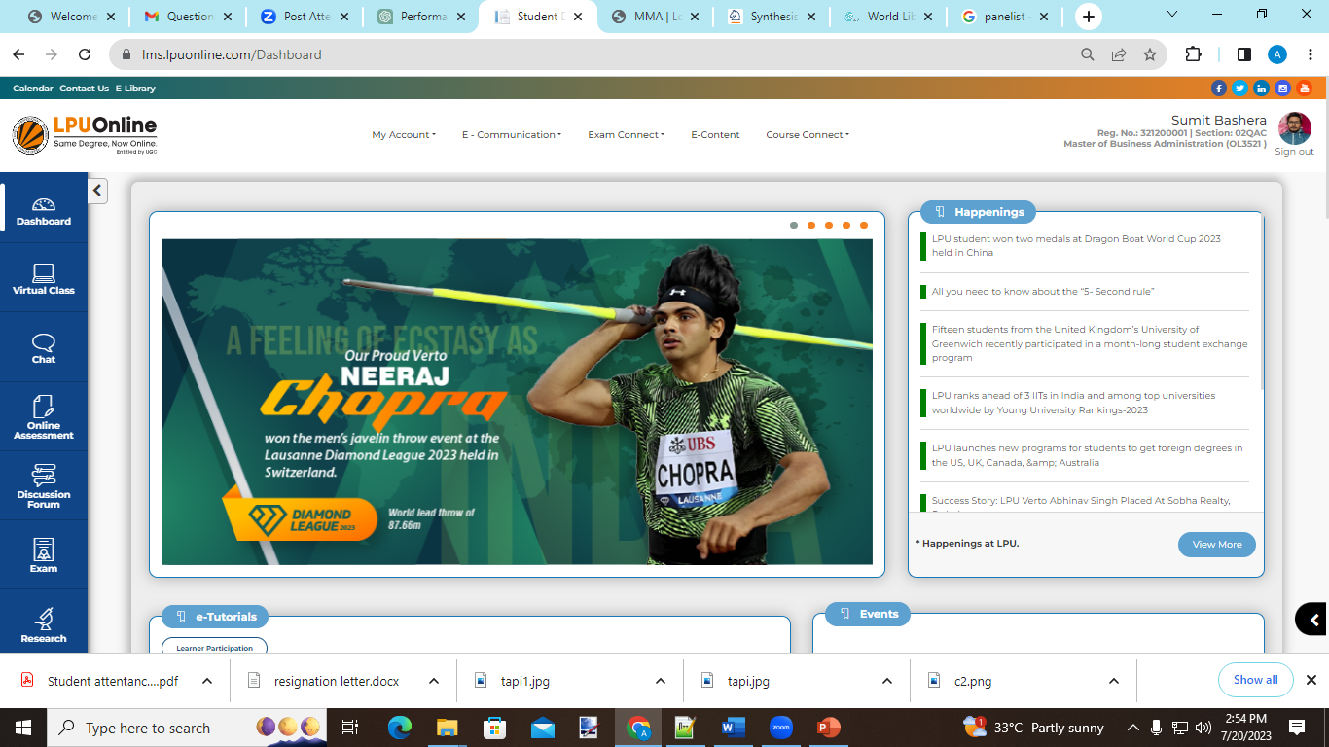
Link for E-Library

Slide 58
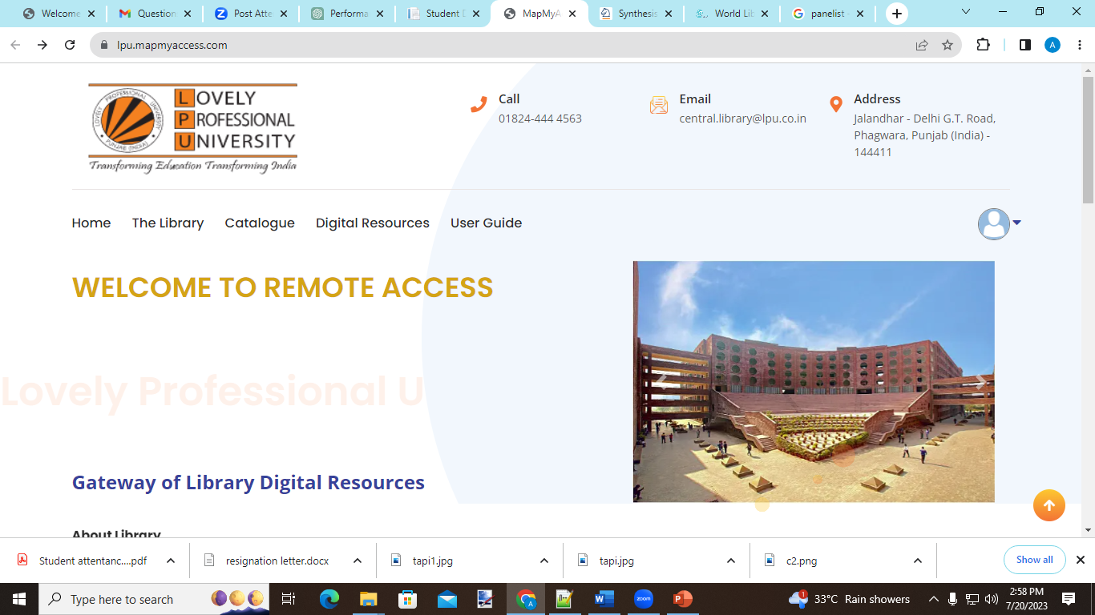
Link for Digital Resources

Slide 59
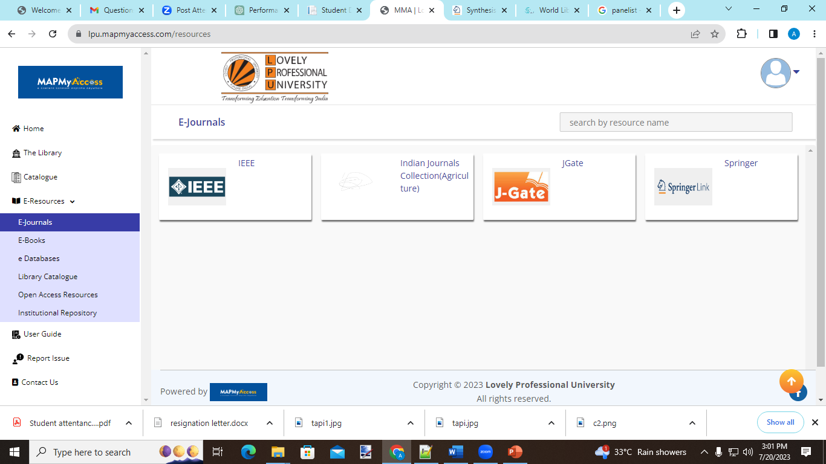
Link for E-Library Resources

Slide 60
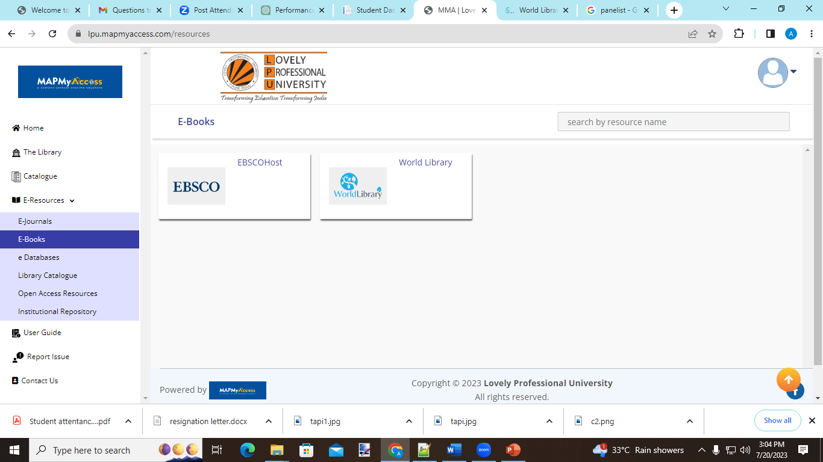
Link for World Library Resources

Slide 61
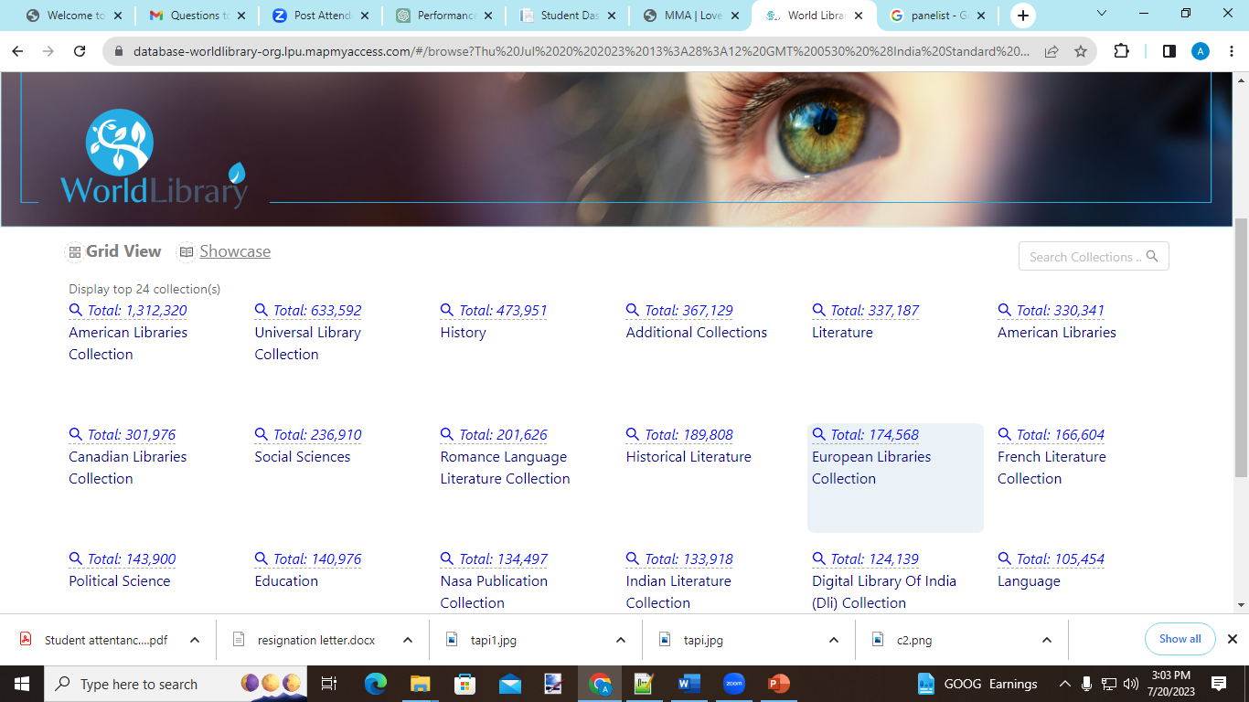

Slide 62
Thank you

