Slide 1


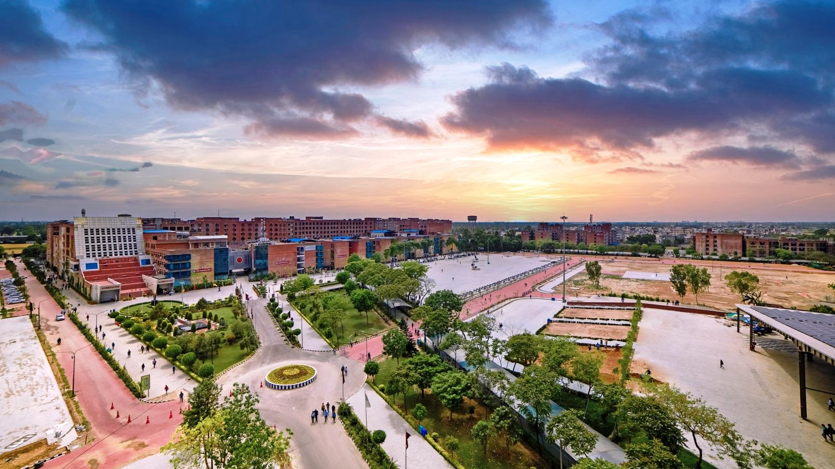
ACADEMIC DETAILS OF LPU ONLINE

Slide 2
IMPORTANT DATES OF LPU ONLINE
For important dates you can refer the link give on the website:
https://www.lpuonline.com/important-dates.php

Slide 3
Recorded Video Lectures
Electronic Learning Material (e- LM)
Virtual Live Classes
Special Classes (Master Class/Guest Lecture/Hands-on Workshop/Professional Enhancement Programme
Discussion Forum
LPU Live
ACADEMIC DELIVERY

Slide 4

1. Recorded Video Lectures (e-Tutorials)
Course-wise Recorded Video Lectures of 20 hours by the expert faculty covering all units of syllabus / e-Learning Material along with the provisions like download video transcript / e-resources, make notes etc. followed with Self Assessment test after every unit.
Duration of Video Lectures per Unit : 1 Hour to 1.30 Hour

Slide 5
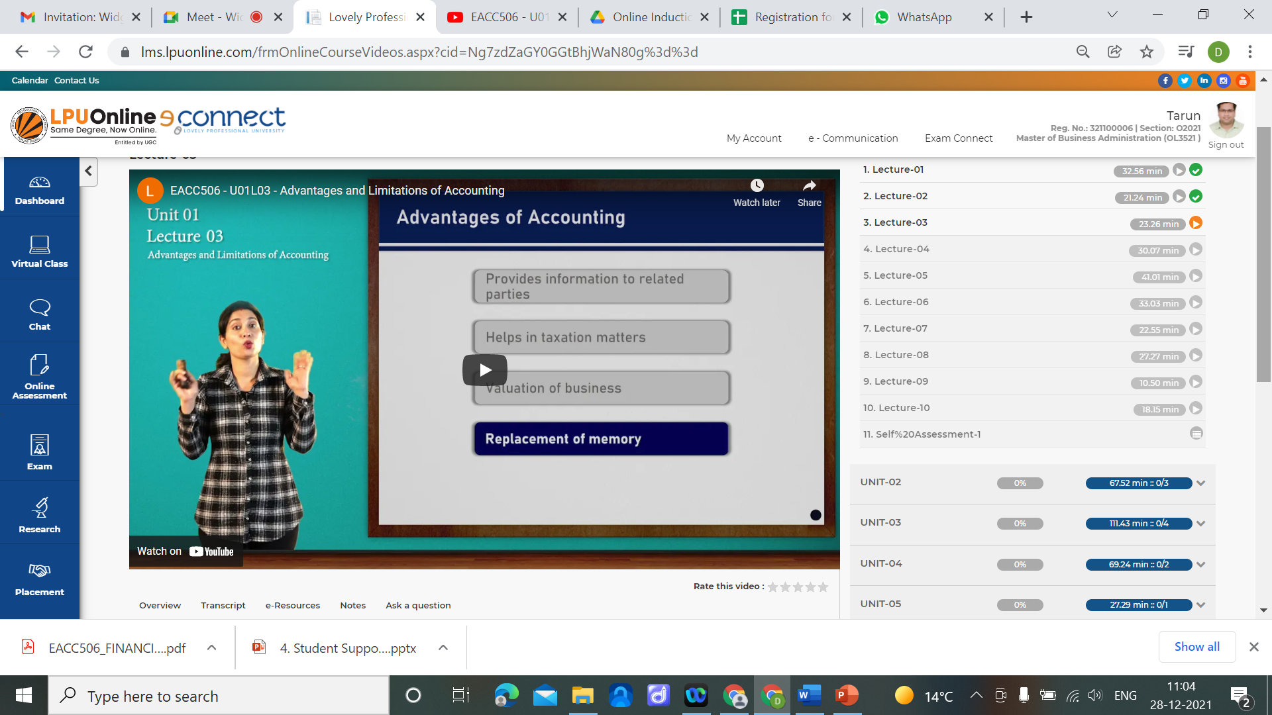
Recorded Video Lectures (e-Tutorials)
Available through Learning Management System .

Slide 6

2. Electronic Learning Material (e-LM)
Content
Summary
Self Assessment Question
Review Question
Further Readings
Web Links

Slide 7

3. Virtual Live Classes
Course-wise 12 live classes by our expert faculty will be conducted on Saturday / Sunday as per dates given in Important dates and Time table for the same will be published on LMS. For Practical subjects also, Live classes will be conducted by Faculty members. Keeping the interest of working students classes are scheduled on Saturdays and Sundays.
Duration of each Class: 1 Hour
Timing of Class: 8 AM to 6 PM
Platform: LPU LMS

Slide 8
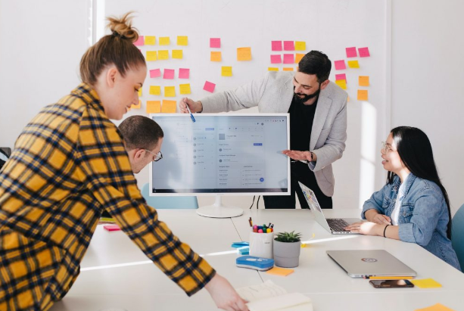
Master Classes
Guest Lectures
Hands-up Workshops
Professional Enhancement Classes
4. Special Classes

Slide 9

Master Classes / Guest Lectures
LPU always believes in providing exposure to its students through Master Classes and Guest Lectures by great leaders, Industry experts & professionals. These Master Classes, Guest Lectures and Hands-on workshops will provide educational inputs to the students based on real life experiences of the experts.

Slide 10
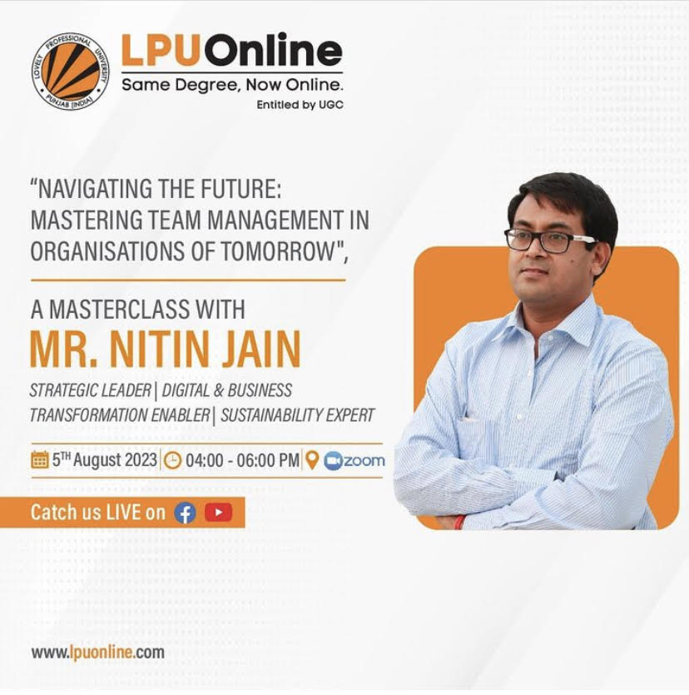
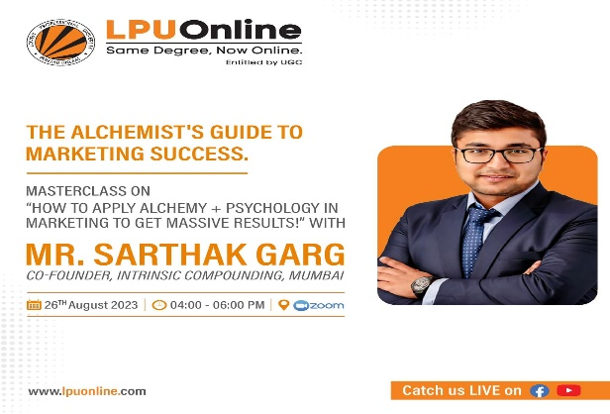
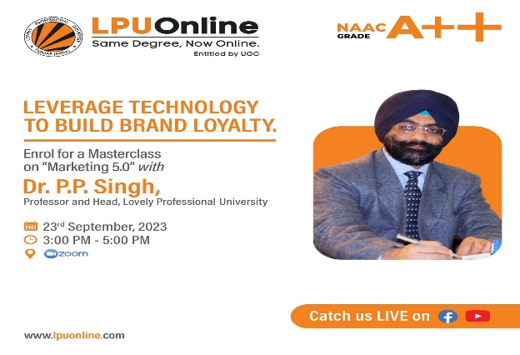

Master Classes/Guest Lectures
Many Industry Expert Lectures, Guest Lectures and Master Classes have been conducted recently for previous session’s LPU Online students.
These lectures by prominent experts are conducted with a mindset to give LPU Online students an industry oriented approach with topics based on their curriculum and general topics as well.
We’ll continue to bring such opportunities for our students to make them future ready.

Slide 11
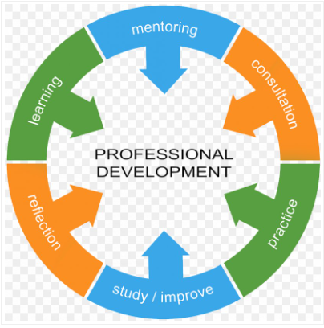
Professional Enhancement Classes
Special classes are organized under Placement Enhancement Program (PEP) where students are trained in aptitude, reasoning, soft skills, interviewing skills, right from the course commencement till their placements.
Objective of Professional enhancement programme is to enhance students’ capabilities as per the career requirements, to create awareness and motivate to acquire add-on skills other than their subject.

Slide 12

5. Discussion Forum
The discussion forum provides opportunity for Students to discuss their Topics / Queries / Doubts, which are responded by peer Students and moderated by Concerned Faculty .

Slide 13

6. LPU Live
Chat: Students can interact with their concerned faculty and peer Students through chat using LPU Live Messenger.

Slide 14
Thank you

