Slide 1


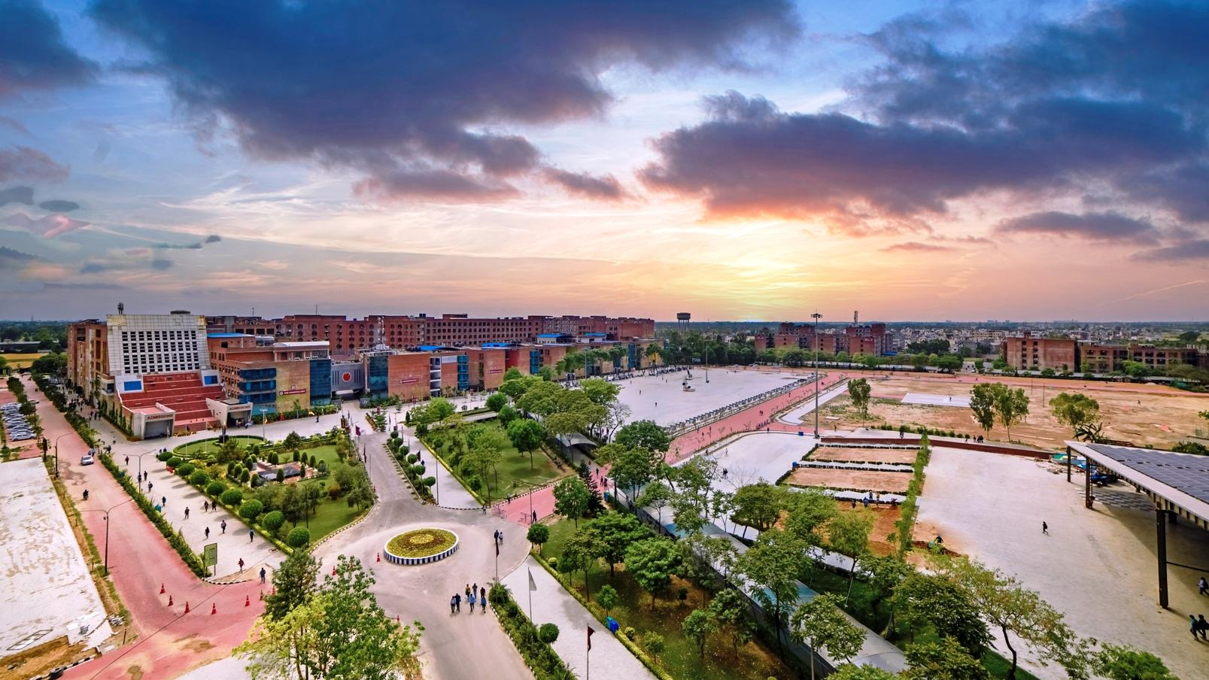
Student Support Services & Website

Slide 2
Medium through which you can reach out to us
RMS-Relationship Management System is an innovative endeavour of the university that provides a platform for students to register suggestions, requests, queries, and feedback regarding various academic or administrative aspects of the university.You can access this platform from your LMS dashboard.
Helpline number- 01824-520500 (9 am - 5 pm)

Slide 3

Relationship Management cell
Helpline number-01824-520500
Working Hours-9 am to 5 pm
A support team has been set up with group of dedicated individuals who would be available to answer your queries and provide you with best solution. You can call them Monday to Saturday any time between 9 AM to 5 PM for any assistance.
LIVE Classes are conducted on weekends and the team is available on weekends between 9 AM to 5 PM to address your issue related to LIVE Classes
The team is entrusted with the sole responsibility of providing the right guidance to students.

Slide 4

Placement support
LPU provides ample opportunities to each and every eligible student to secure good placement with the help of a dedicated Division of Career Services.
University provides placement support to its Online Learning students by informing them time to time about all placement drives.
The mission is to engage and enable our students by creating meaningful learning platforms aimed at building skills and competency in order to ensure their holistic growth.
For any placement related queries, you can email us @ placements@lpuonline.com or call us at 01824-520500.

Slide 5
Placement support
Professional Enhancement Programme
Aptitude Training
Soft Skill Development
Mock Interviews
Special classes are organized under Placement Enhancement Program (PEP) where students are trained in aptitude, reasoning, soft skills, interviewing skills, right from the course commencement till their placements.
Objective of Professional enhancement programme is to enhance students’ capabilities as per the career requirements, to create awareness and motivate to acquire add on skills other than their subject.

Slide 6


Soft skill development & Mock Interviews
To improve interpersonal skills and hone placement ability, soft skills are taught in the university.
Mock Interviews will give you an opportunity to practice what to say and do during an interview and get feedback. The online interview will help to evaluate yourself in terms of your body language, your confidence

Slide 7
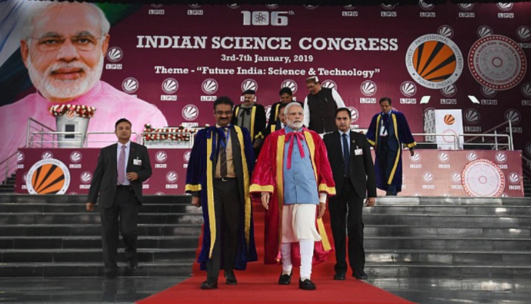
Opportunities to be part of mega events at LPU
Online students will be given equal opportunity to witness and participate in various University events
In the past Hon’ble Prime Minister of India, Shri Narendra Modi Inaugurated The 106th India Science Congress (ISC) at LPU and you can witness all such great events.

Slide 8
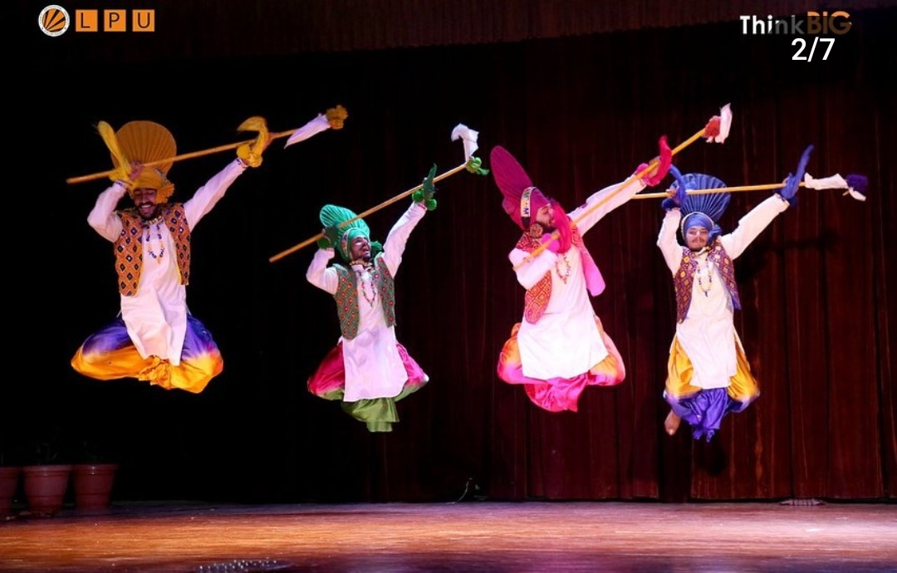
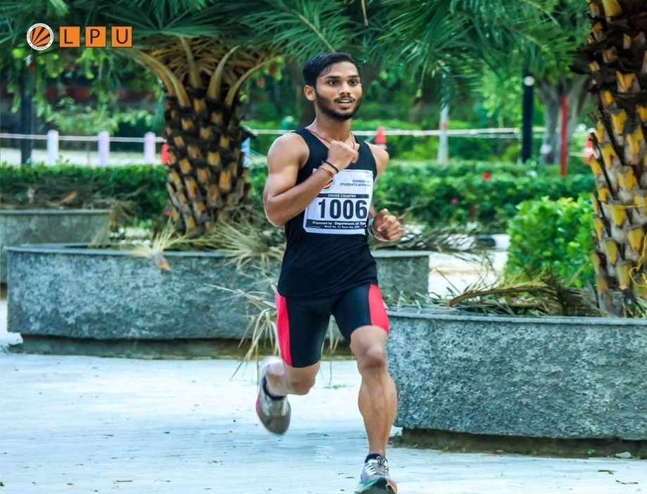
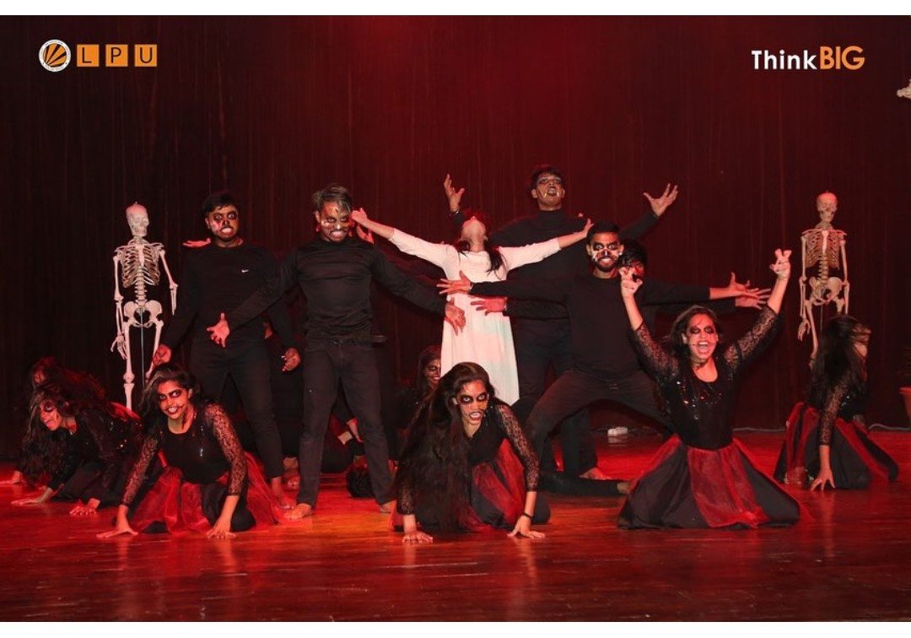
CULTURAL AND SPORTS EVENTS
The Online Learners can showcase their talent by participating in various academic, cultural, sports events and more.
You must have heard of the One India, One world event in which students from all states of India and different countries comes under one roof and perform. So you can be a part of such mega events.
Recently we have invited registrations from our Online learners for the participation in the Inter-departmental Sports Events.
For all such events, we put communication in the announcement section of the LMS.

Slide 9
Website- Home Page

Slide 10
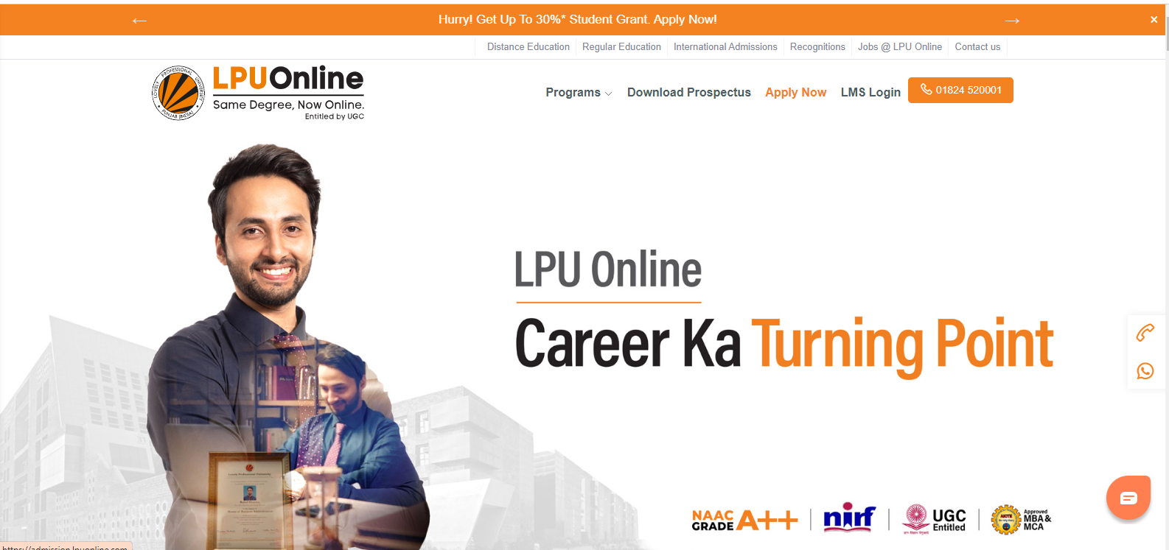
link for home page: https://www.lpuonline.com/

Slide 11
Programme Guide
Programme Guides- Students can download programme guides for all programmes from the website. Student can access the programme page for whichever programme they are enrolled and can download the programme guide from the Curriculum section. Programme Guide will help you know programme structure, scheme and detailed information about your courses and electives. The same is also available on the LMS portal.
Students can also access the LMS through the website, through the “LMS Login” option given in the Top Right Corner of the Homepage.

Slide 12
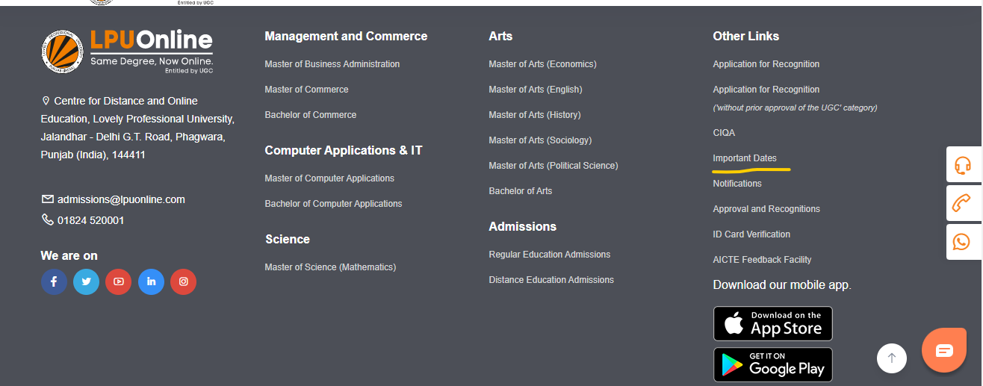
Important Dates
Important Dates- Important Dates document is available in the footer section of the LPU Online website. It contains all important dates you would need to know throughout your session.
Screenshot:

Slide 13
Social Media Links

Slide 14

Facebook
URL: www.facebook.com/LPUOnline

Slide 15
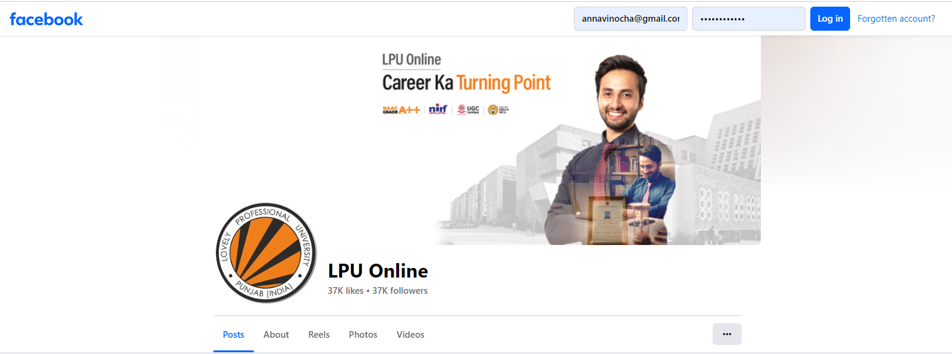
Facebook

Slide 16


Instagram
URL: www.instagram.com/Onlinelpu

Slide 17
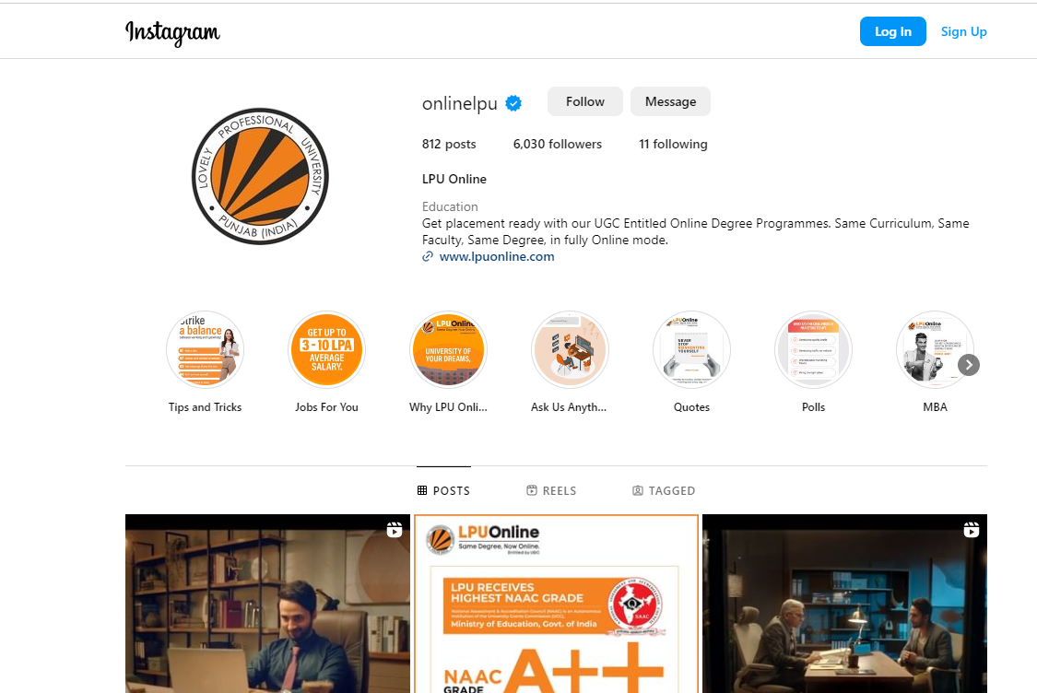
Instagram

Slide 18

LinkedIn
URL: www.linkedin.com/company/lpuonline

Slide 19
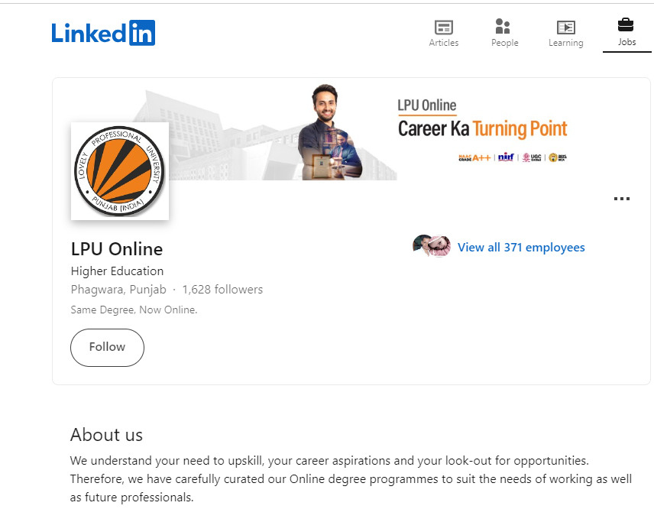
LinkedIn

Slide 20

Twitter
URL: https://twitter.com/LpuOnline

Slide 21
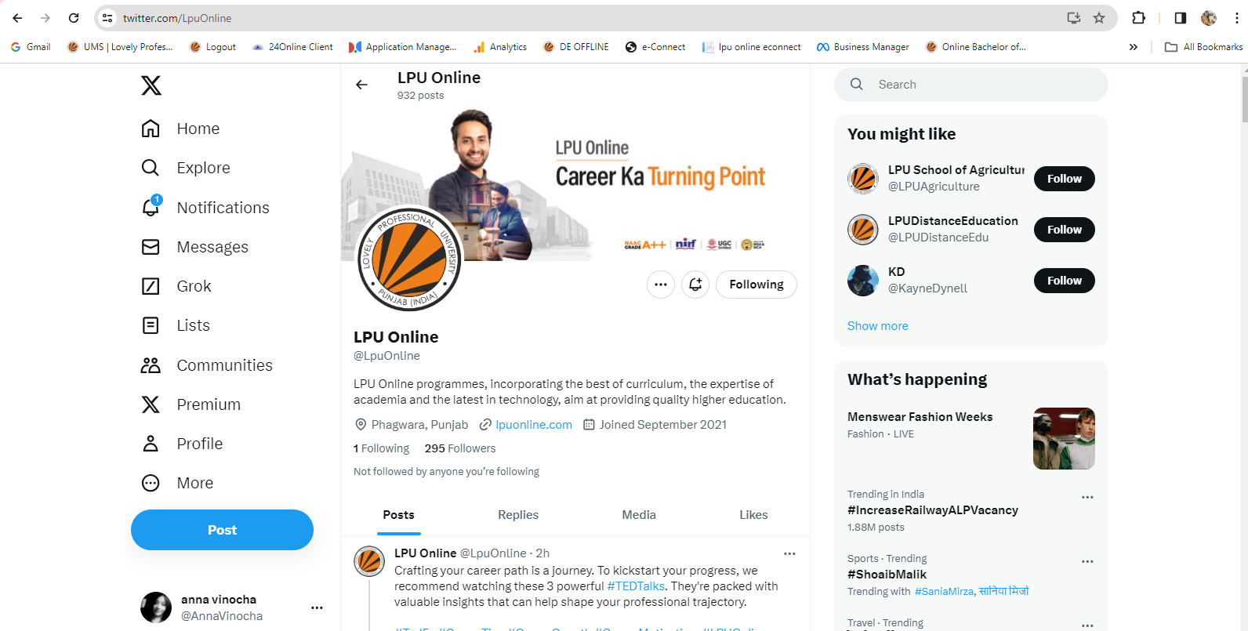
Twitter

Slide 22

YouTube
URL: https://www.youtube.com/c/LPUOnlineEducation

Slide 23
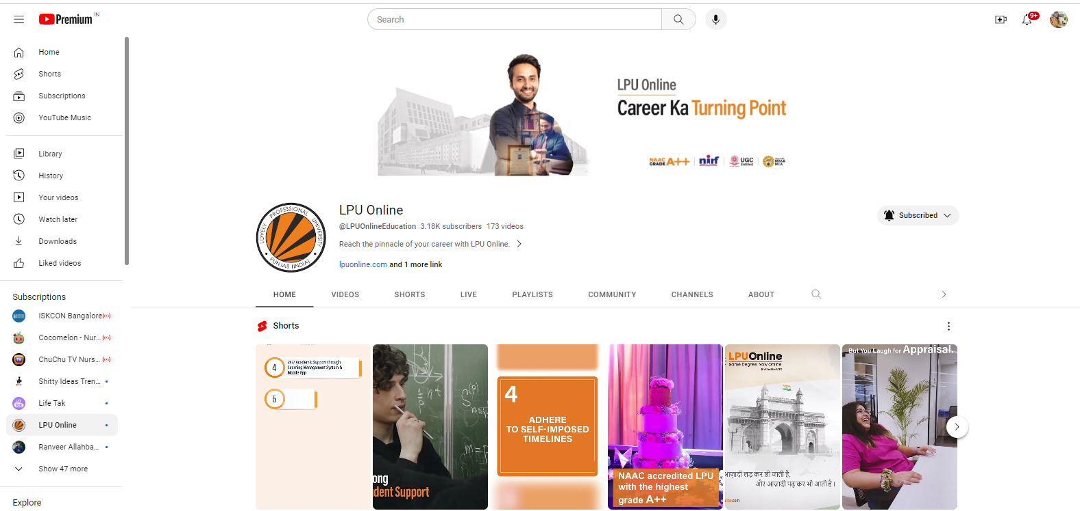
YouTube

Slide 24
Thank you

